Slide 1
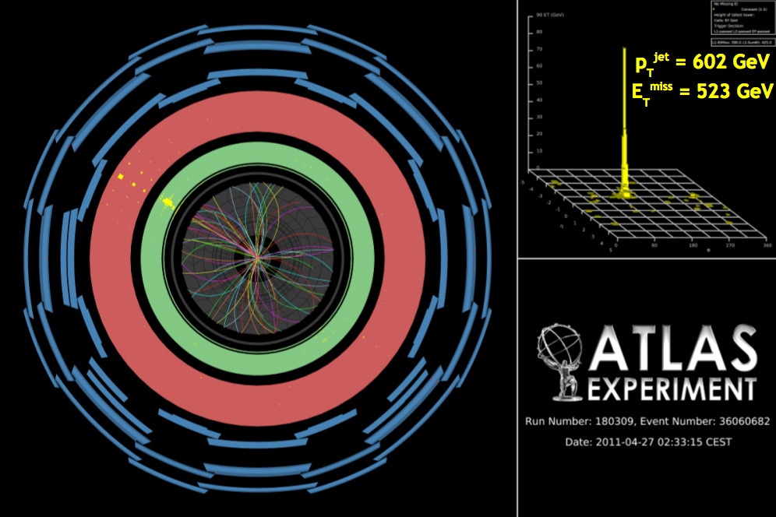
LHC monojet measurements and interpretations
Measurements by ATLAS and CMS
ADD interpretations
WIMP interpretations
David Berge, CERN, ATLAS

Slide 2
Final state
MET
y
Signal
x
Jet
Jet
Backgrounds
ν
ν
Z
Irreducible SM background, 50% to 80% of total background depending on MET cuts.
Jet
Jet

Slide 3
Final state
MET
y
Signal
x
Jet
Jet
Backgrounds
ν
l (lost)
W
Reducible SM background, 20% to 50% of total background depending on MET cuts.
Jet
Jet

Slide 4
Final state
MET
y
Signal
x
Jet
Jet
Backgrounds
Jet
QCD background from jet mismeasurement, almost negligible due to Δφ cuts (1-2%).
Jet
Jet

Slide 5
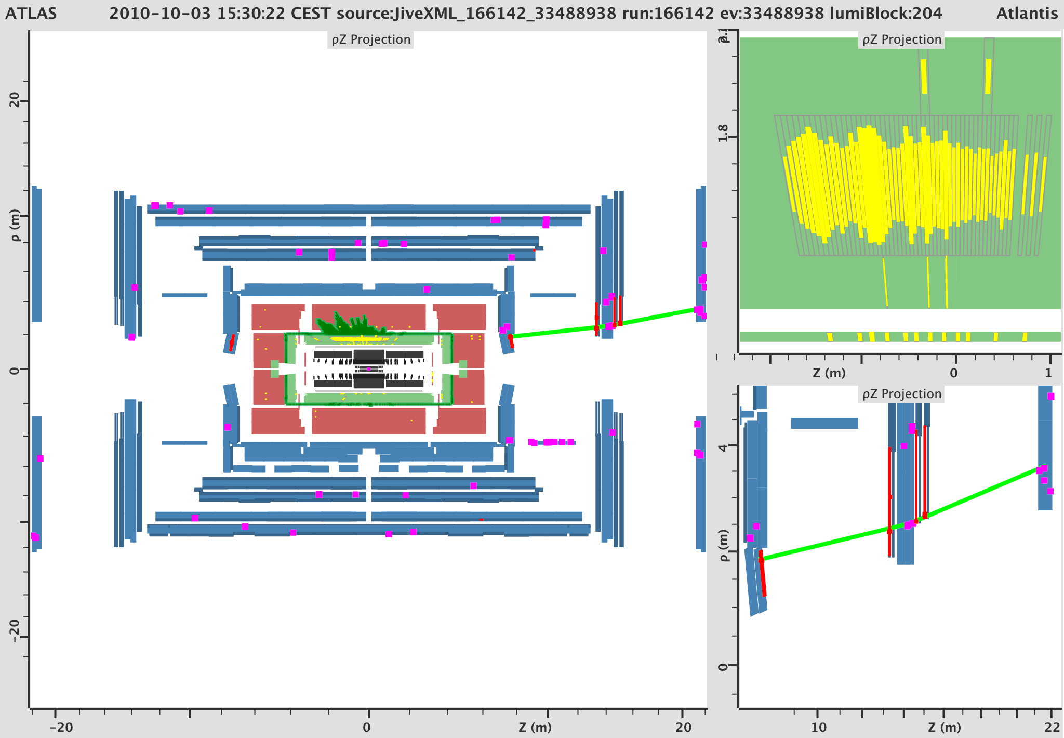
Final state
ATLAS-CONF-2011-137
Backgrounds
Non-collision backgrounds (cosmics, beam halo, beam gas, noise bursts), small nuisance at LHC (1-2%).

Slide 6
2010 Data (35pb⁻¹) – Journal Publications
ATLAS
CMS
http://arxiv.org/abs/1106.5327
Isolated lepton veto (20 / 10 GeV for e / μ)
Low pt:
  Lead jet pt > 120 GeV, |η| < 2.0
  2nd jet veto pt < 30 GeV, |η| < 4.5
  MET > 120 GeV
Hight pt:
  Lead jet pt > 250 GeV, |η| < 2.0
  2nd jet veto < 60 GeV, |η| < 4.5
  3rd jet veto < 30 GeV, |η| < 4.5
  MET > 220 GeV
  Δφ(j2,MET) > 0.5
ADD limits
http://arxiv.org/abs/1106.4775
Isolated lepton veto (20 GeV for both e / μ)
MET > 150 GeV
Lead jet pt > 110 GeV, |η| < 2.4
No 2nd jet veto, but N_{jets} <3 and Δφ (j1,j2) < 2.0
3rd jet pt < 30 GeV
τ veto
ADD and unparticle limits

Slide 7
2011 Data (1.1fb⁻¹) – Conference Notes
ATLAS
CMS
http://cdsweb.cern.ch/record/1369187
Isolated lepton veto (20 / 10 GeV for e / μ)
Low pt:
  Lead jet pt > 120 GeV, |η| < 2.0
  2nd jet veto pt < 30 GeV, |η| < 4.5
  MET > 120 GeV
Hight pt:
  Lead jet pt > 250 GeV, |η| < 2.0
  2nd jet veto < 60 GeV, |η| < 4.5
  3rd jet veto < 30 GeV, |η| < 4.5
  MET > 220 GeV
  Δφ(j2,MET) > 0.5
Very hight pt:
  Lead jet pt > 350 GeV, |η| < 2.0
  2nd jet veto < 60 GeV, |η| < 4.5
  3rd jet veto < 30 GeV, |η| < 4.5
  MET > 300 GeV
  Δφ(j2,MET) > 0.5
ADD limits
http://cdsweb.cern.ch/record/1376675
Isolated lepton veto (20 GeV for both e / μ)
Low to high MET:
  MET > 200 GeV
  MET > 250 GeV
  MET > 300 GeV
  MET > 350 GeV
  MET > 400 GeV
Lead jet pt > 110 GeV, |η| < 2.4
No 2nd jet veto, but N_{jets} <3 and Δφ (j1,j2) < 2.0
3rd jet pt < 30 GeV
τ veto
ADD limits

Slide 8
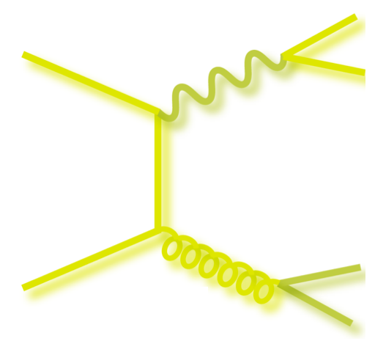
Electroweak Backgrounds
Main backgrounds:
Undetected
ν
l
Z
ν
W
ν
jet
jet
Data driven estimates:
CR: invert lepton veto
ATLAS: subtract ttbar MC, take scale factor data/MC in CR to rescale MC in SR
CMS: same for W+jets, for Z+jets they are taking the Z->ll data estimate, plus acceptance & efficiency differences from MC and rescale for BR’s
Detected
e,μ
e,μ
W
Z
ν
e,μ
jet
jet

Slide 9
Electroweak Backgrounds ATLAS
Keep signal selection of large MET and a single jet, add a single lepton requirement (e 20 GeV, μ 10 GeV)
This is found to result in approx: 80% W->e,μ ν, 15% W->τ ν, 5% ttbar (for the latter the MC estimate is subtracted, with assumed 20% total systematic uncertainty – 2% on the result)
Muon sample:
  Data / MC scale in control region to normalise W->μν+jets, Z->νν+jets, Z->μμ+jets MC in signal region
Electron sample:
  Data / MC scale in control region to normalise W->eν+jets, W->τν+jets, Z->ττ+jets MC in signal region

Slide 10
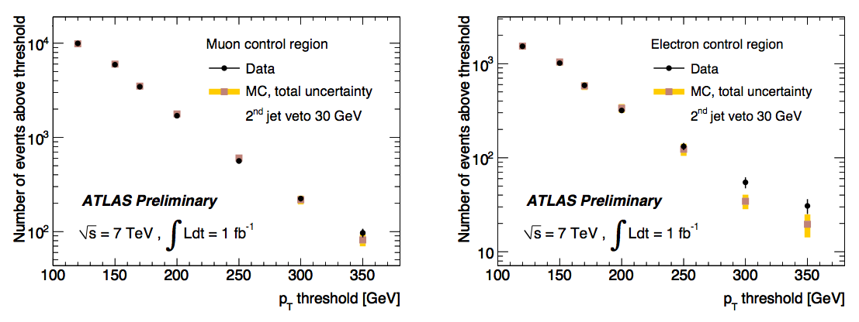
Electroweak Backgrounds ATLAS
Scale factor cross checks: no dependence on kinematic cuts found
Within statistics scale factors from direct Z or W selection (plus a high-pt jet and large MET in the W selection) agree
Systematic uncertainty on bg estimate:
  Uncertainties on lepton ID (4%), ttbar MC (2%), statistics in CR summed in quadrature
Control regions after scaling, data versus sum of MC:

Slide 11
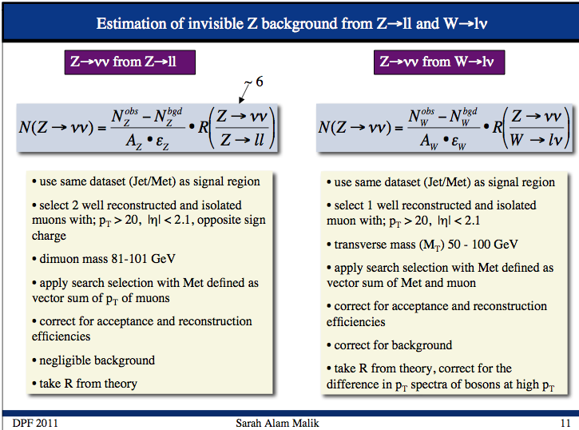
Electroweak Backgrounds CMS

Slide 12
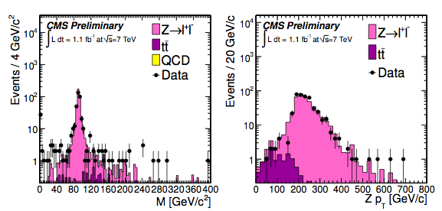
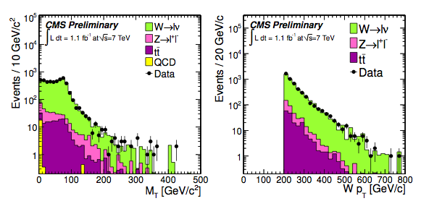
Electroweak Backgrounds CMS
Z and W background samples
MC normalised to data
Data estimate / scale factors only done for muons

Slide 13
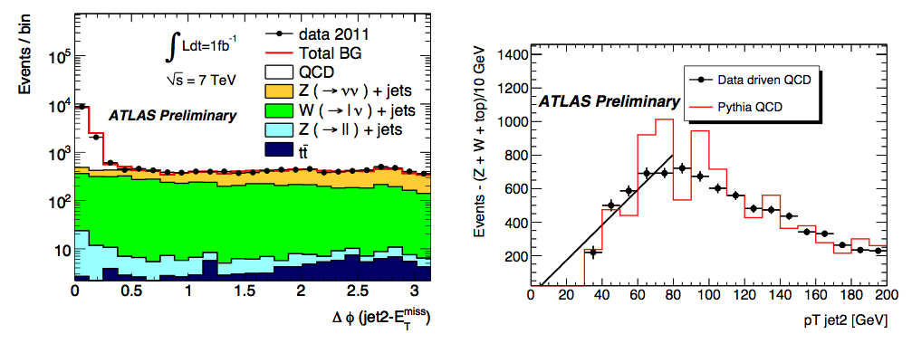
Remaining Backgrounds
QCD multijets
  CMS from MC
  ATLAS from data where sufficient statistics, else negligible
Ttbar from MC (negligible in all cases)
Noncollision backgrounds
  Ignored by CMS, estimated from data by us
  Data estimates: jets in unpaired and empty crossings in 2010, David’s beam-halo tagger in 2011…
ATLAS QCD estimate: drop jet veto and Δφ cut, subtract other bg from MC, fit data in Δφ<0.5
Bg estimate from fit <30 GeV

Slide 14
Remaining Backgrounds
QCD multijets
  CMS from MC
  ATLAS from data where sufficient statistics, else negligible
Ttbar from MC (negligible in all cases)
Noncollision backgrounds
  Ignored by CMS, estimated from data by us
  Data estimates: jets in unpaired and empty crossings in 2010, David’s beam-halo tagger in 2011…
ATLAS QCD estimate: drop jet veto and Δφ cut, subtract other bg from MC, fit data in Δφ<0.5
Systematics from varying fit parameters within errors, adhoc 20% on top background:
Bg estimate from fit <30 GeV

Slide 15
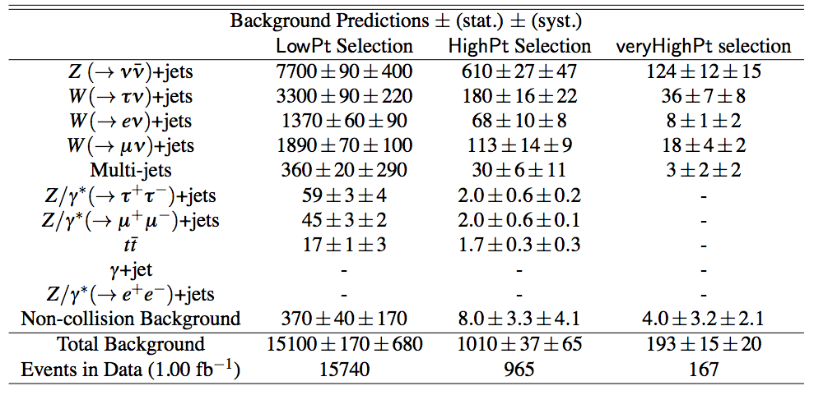
Grand total ATLAS
Statistical error is statistics in MC, systematics is lepton ID, ttbar subtraction, statstics in CR

Slide 16
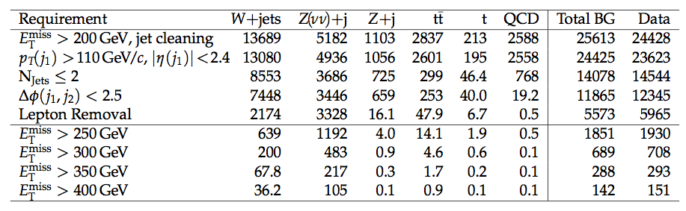
Grand total CMS

Slide 17
Total background uncertainties 2011
CMS only quote total (stat+syst) uncertainties for the 200 GeV MET analysis
 | ATLAS lowpt | ATLAS highpt | ATLAS veryhighpt | CMS 200 GeV MET
Statistical error | 1.1% | 3.7% | 7.8%
Systematic error | 4.5% | 6.4% | 10%
Total error | 4.6% | 7.4% | 12.7% | 5.5%

Slide 18
Signal systematic uncertainties
 | ATLAS low/high pt | CMS low/high pt
PDF | 6% / 7% | 1-3% / 3-8%
ISR / FSR | 13% | <2%
Q² scale | 11% | -
JES | 5% / 6% | 8-11% / 10-20%
JER | 3% / 1% | -
Pile-up | 3% / 2% | 3%
Luminosity | 3% | 5%
Total | 20% / 20% | 12% / 22% (take largest quote everywhere)

Slide 19
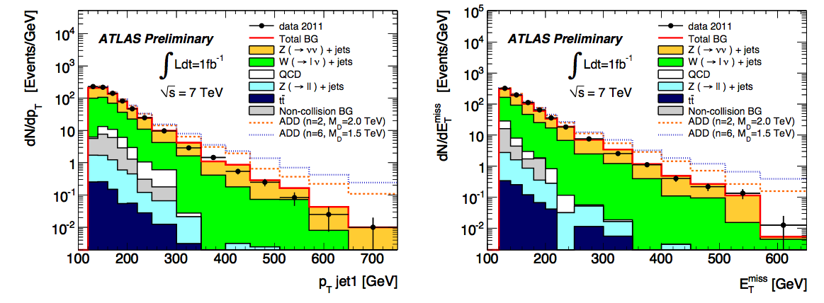
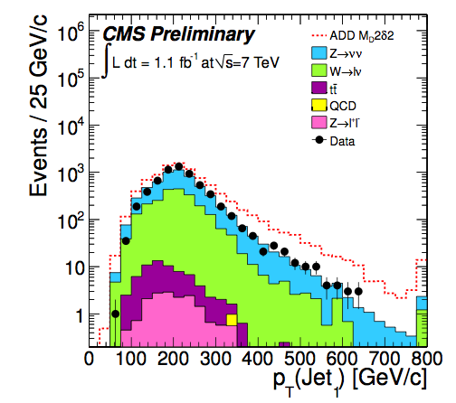
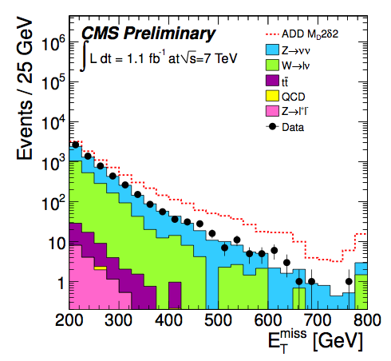
Results

Slide 20
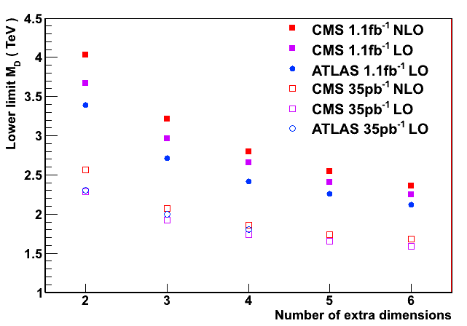
ADD Limits Overview
CMS are taking sizeable K factors into account (1.5 for δ = {2,3}, 1.4 for δ = {4,5}, ATLAS doesn’t
LO limits better for CMS due to larger MET cut
We have discussed ultraviolet behavior of ADD
  Effective theory used to compute ADD cross sections
  Only valid if event scale below M_{D}
  In 2010 we didn’t quote δ={5,6} M_{D} values because of this, in 2011 we decided to quote both M_{D} (with and without suppression of region s-hat > M_{D}²)
ATLAS quotes fiducial cross section limits for all 3 selections (both at detector level, but also unfolded)

Slide 21
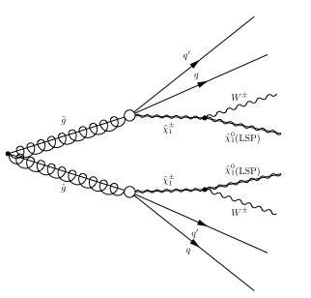
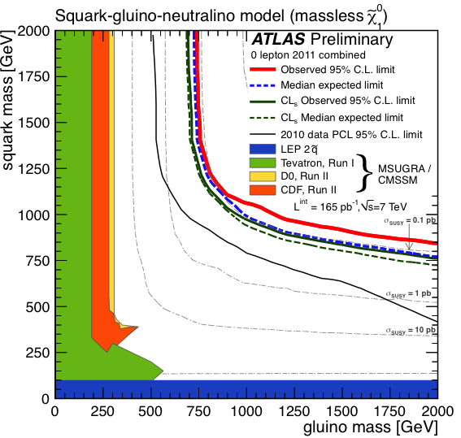
1: “Standard” Dark Matter Searches at Colliders
One possibility: search for large missing ET in cascade decays
jet
jet
jets/lepton
X
ET^{miss}
p
p
experimental signature:
jets + (leptons) + ET^{miss}
[2 LSPs escape scape detection]
... + χ⁰1

Slide 22
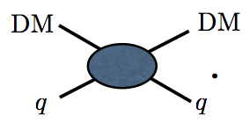
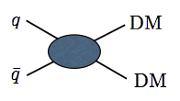
2: Generic WIMP Searches at Colliders
Consider WIMP pair production at colliders, idea goes back to:
  First paper
  Maverick Dark Matter (Kolb, Hooper etc)
Latest papers about ATLAS 1fb⁻¹ result:
  arxiv:1109.4398 (FNAL crew)
  arxiv:1108.1196 (UCI crew)
All based on the idea:
Direct DM searches:
Colliders:
SM
SM
SM
SM
If this interaction exists…
… this one must exist, too.

Slide 23
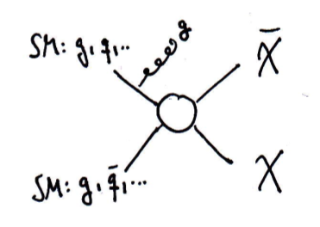
Generic WIMP Searches at Colliders
Search for WIMP pair production
Assume:
WIMP exists and can be pair produced
Dark Matter candidate the only particle within reach
Effective field theory approach, integrate out new heavy mediator
WIMP—SM coupling set by m_{χ} and suppression scale Λ
Require hard jet to recoil against WIMPs thereby creating missing ET (otherwise no trigger)
Monojet searches…
Notes:
Don’t assume any model
Just assume that WIMPs exist and can be pair produced at LHC
Then treat pair creation as a contact operator and do an effective field theory Ansatz, just like Fermi it for the 4-fermion contact interaction before the W boson could be resolved.
One has to pick out only the subset of events with a hard radiation jet recoiling against the WIMPs, otherwise the trigger and usual event selections would not select these events
The contact operator for example for a vector interaction looks like this, there are other operators to be considered (scalar, axial-vector, pseudo-scalar) which can result in different rates for chichi bar
The suppression scale, in case of a non-detection, would be used to set bounds on, from the cross section limit. Interestingly, these limits on lambda can be translated into bla
Positive signals in this final state are probably not the first sign we see (other analyses should see excess earlier), moreover we will have to try to derive from jet pt shapes or MET spectrum information about the underlying physics, which isn’t easy. As I said, we may already have other hints from LHC analyses by then, which would need to be combined to try and learn something about the Dark Matter properties.
Check dilepton edges!

Slide 24
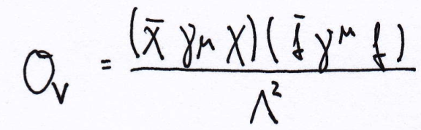
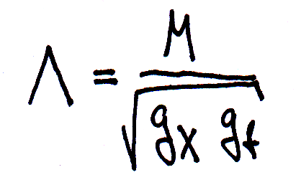
Generic WIMP Searches at Colliders
Search for WIMP pair production
Assume:
WIMP exists and can be pair produced
Dark Matter candidate the only particle within reach
Effective field theory approach, integrate out new heavy mediator
WIMP—SM coupling set by m_{χ} and suppression scale Λ
Require hard jet to recoil against WIMPs thereby creating missing ET (otherwise no trigger)
Monojet searches…
Contact operators e.g. vector coupling:
Production cross section dependence:
σ(Λ⁻⁴,m_{χ})
Supression scale:
Notes:
Don’t assume any model
Just assume that WIMPs exist and can be pair produced at LHC
Then treat pair creation as a contact operator and do an effective field theory Ansatz, just like Fermi it for the 4-fermion contact interaction before the W boson could be resolved.
One has to pick out only the subset of events with a hard radiation jet recoiling against the WIMPs, otherwise the trigger and usual event selections would not select these events
The contact operator for example for a vector interaction looks like this, there are other operators to be considered (scalar, axial-vector, pseudo-scalar) which can result in different rates for chichi bar
The suppression scale, in case of a non-detection, would be used to set bounds on, from the cross section limit. Interestingly, these limits on lambda can be translated into bla
Positive signals in this final state are probably not the first sign we see (other analyses should see excess earlier), moreover we will have to try to derive from jet pt shapes or MET spectrum information about the underlying physics, which isn’t easy. As I said, we may already have other hints from LHC analyses by then, which would need to be combined to try and learn something about the Dark Matter properties.
Check dilepton edges!

Slide 25


Generic WIMP Searches at Colliders
Parametrise WIMP-SM interactions with various dim-6 operators:
arxiv:1108.1196

Slide 26
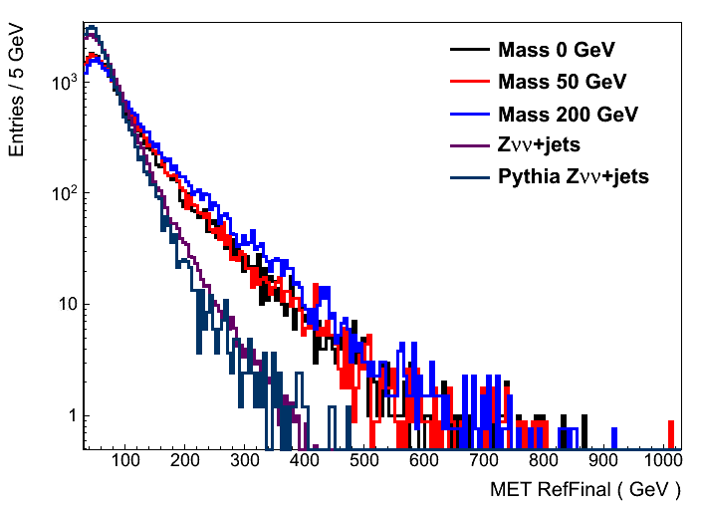
Expected signal MET distributions
Truth-level, private plot
Vector operator, histograms scaled to the same area
Alpgen Zνν+jets
Pythia Zνν+jets
MET ( GeV )
Expect harder MET spectrum even for m_{χ}= 0 GeV!

Slide 27
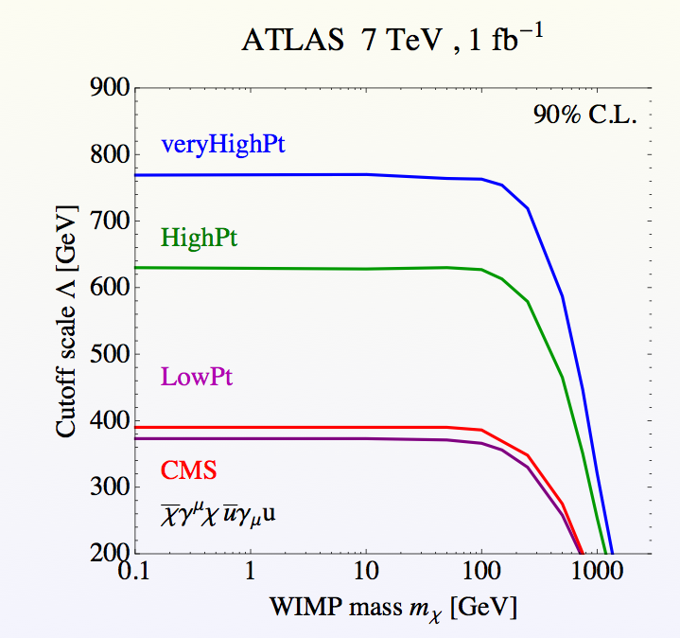
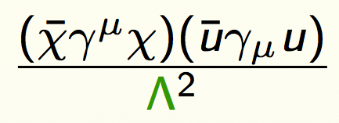
Limits on suppression scale Λ
Take vector operator as example
Convert cross section limits into limit on Λ for particular m_{χ}
arXiv:1109.4398

Slide 28
Limits in direct detection plane
SM
SM
Nucleon
Nucleon
Now convert the high-energy limit on Λ into limits on σ_{χ-Nucleon}, by converting quark-level to Nucleon-level matrix elements.
Caveats:
Important uncertainty: hadronic matrix elements
SI vs SD interactions depending on operator
Simple transfer of LHC measurement to direct-detection plane doesn’t always work, e.g.
  Light mediators
  Non-flavour-universal interaction

Slide 29
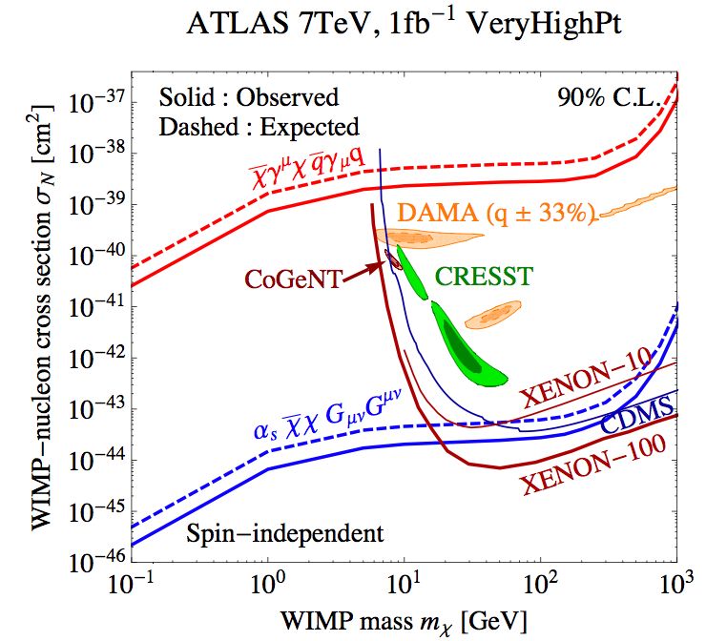
Spin independent Nucleon-WIMP scattering cross section
LHC measurement translates into at least one line per operator (and are only correct for heavy mediators)
Low-mass LHC reach complementary to DD experiments
LHC limits don’t suffer from astrophysical uncertainties
arXiv:1109.4398

Slide 30
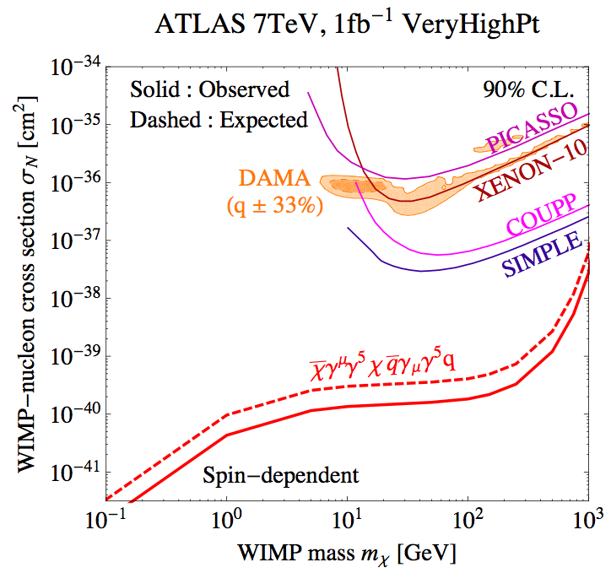
Spin dependent Nucleon-WIMP scattering cross section
LHC measurement translates into at least one line per operator (and are only correct for heavy mediators)
Low-mass LHC reach complementary to DD experiments
LHC limits don’t suffer from astrophysical uncertainties
arXiv:1109.4398

Slide 31
ATLAS Monojet Outlook
5.2 fb⁻¹ now delivered, 5fb⁻¹ recorded by ATLAS, some 4.5 fb⁻¹ will pass quality cuts and appear in the next monojet paper (planned for Moriond)
Additional interpretations besides ADD are planned to be included (e.g. EFT approach for WIMP pairs)

Slide 32
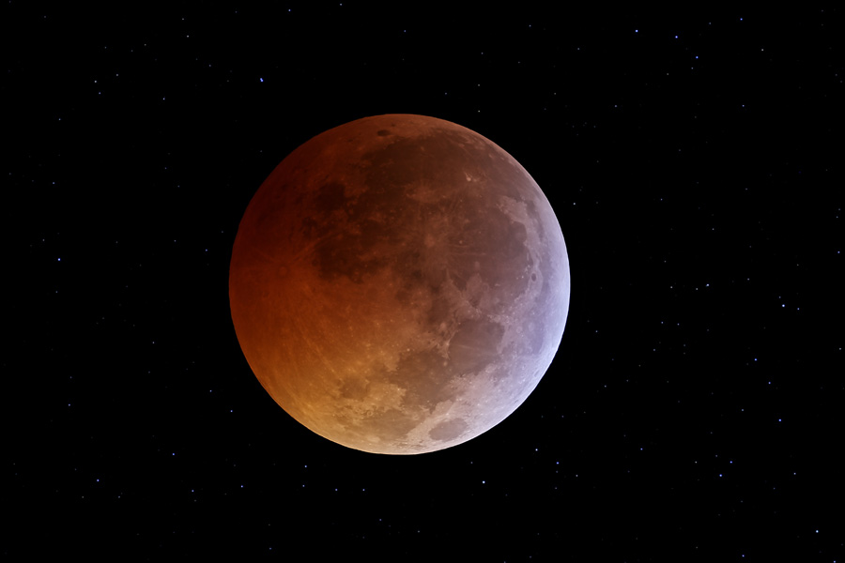

Slide 33
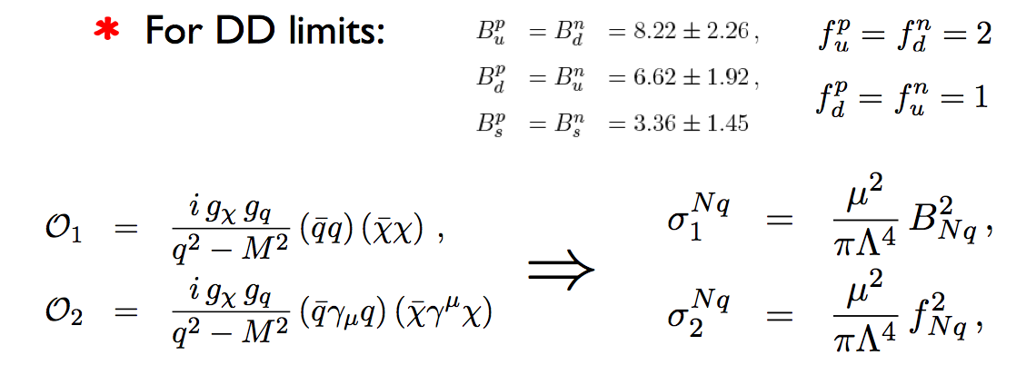
Limits in direct detection plane
SM
SM
Nucleon
Nucleon
Now convert the high-energy limit on Λ into limits on σ_{χ-Nucleon}, by converting quark-level to Nucleon-level matrix elements:

Slide 34
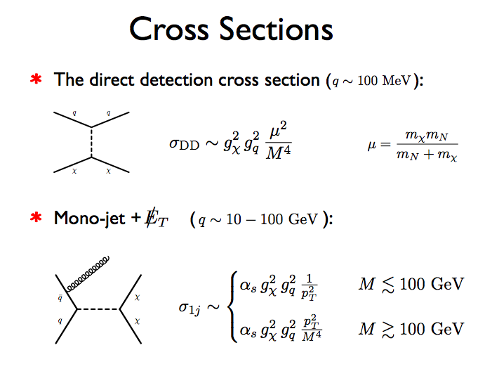
Roni Harnik

Slide 35
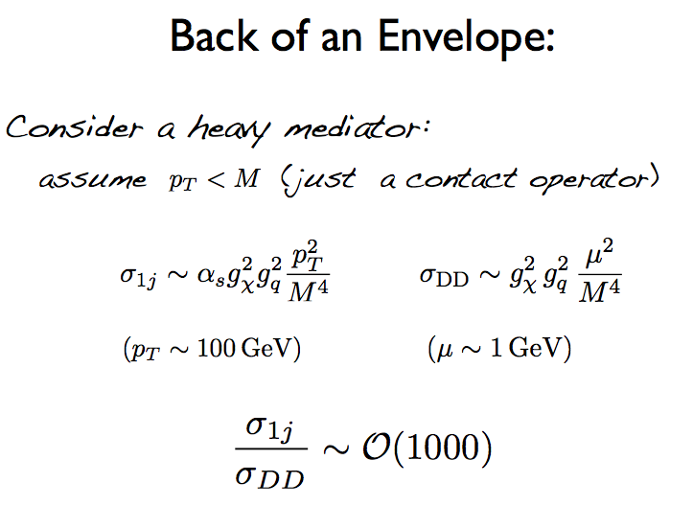
Roni Harnik

Slide 36
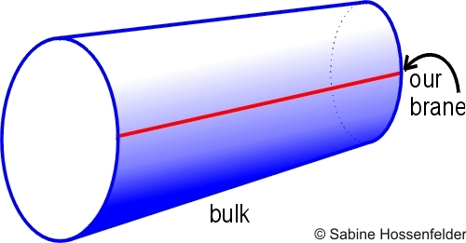

Interpretations: ADD
SM confined to brane, graviton propagates in the bulk (4+n dimensions)
Extra dimensions are compactified, lead to Kaluza-Klein towers of massive graviton modes
Signatures: monojet (graviton emission), non-resonant diphoton or dilepton production (virtual graviton exchange)

