Slide 1
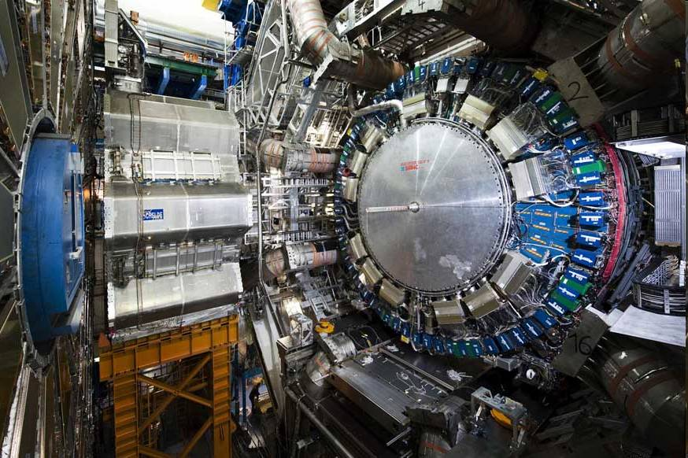
Searches for Squarks and Gluinos in the Jets + MET + 0-Lepton Channel at ATLAS
Dan Tovey
University of Sheffield
On behalf of the ATLAS Collaboration

Slide 2
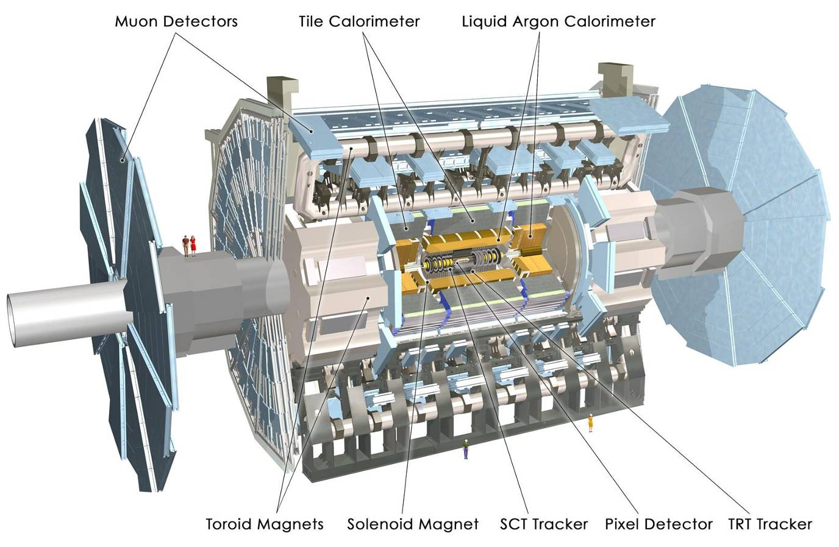
The ATLAS Detector
Muon Spectrometer (|η|<2.7) : air-core toroids with gas-based muon chambers
Muon trigger and measurement with momentum resolution < 10% up to E_{μ} ~ 1 TeV
Length : ~ 46 m
Radius : ~ 12 m
Weight : ~ 7000 tons
~10⁸ electronic channels
3000 km of cables
3-level trigger
reducing the rate
from 40 MHz to
~200 Hz
Inner Detector (|η|<2.5, B=2T):
Si Pixels, Si strips, Transition Radiation detector (straws)
Precise tracking and vertexing,
e/π separation
Momentum resolution (η=0):
σ/p_{T} ~ 3.8x10⁻⁴ p_{T} (GeV) ⊕ 0.015
EM calorimeter: Pb-LAr Accordion
e/γ trigger, identification and measurement
E-resolution: σ/E ~ 10%/√E
HAD calorimetry (|η|<5)
Fe/scintillator Tiles (central), Cu/W-LAr (fwd)
Trigger and measurement of jets and missing E_{T}
E-resolution: σ/E ~ 50%/√E ⊕ 0.03

Slide 3
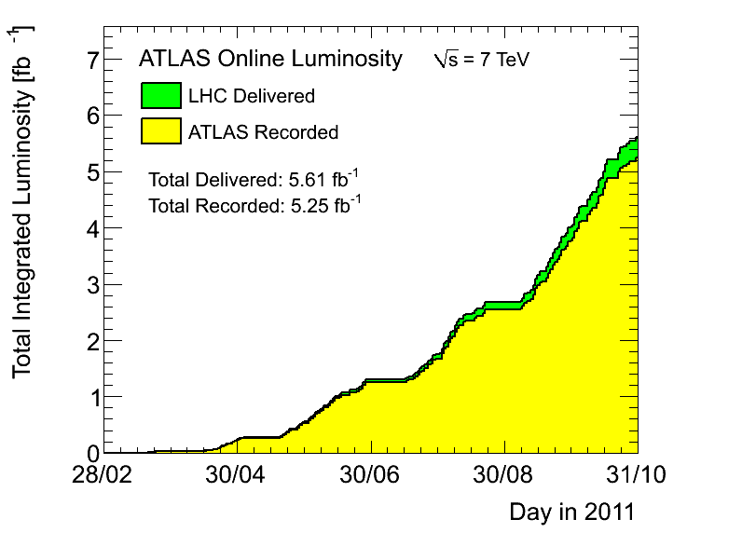
Luminosity

Slide 4
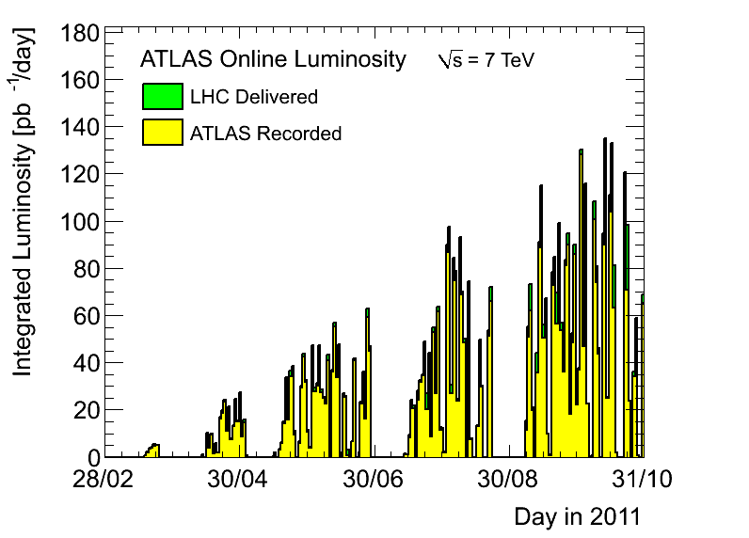
Luminosity

Slide 5
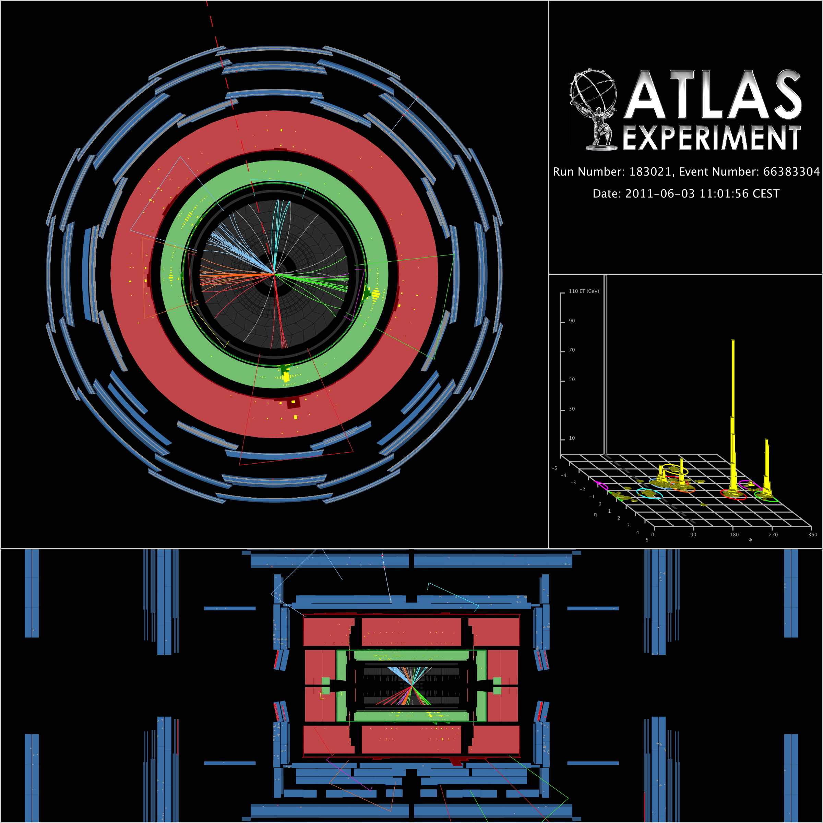
Motivation
Strong production (squarks, gluinos) dominates SUSY cross-section unless large mass hierarchy (1)
LSP/DM production generates MET even without leptons (2)
SM real MET signature usually accompanied by leptons (except Z→νν) (3)
Implies require jets (1), MET (2) and veto leptonic events (3)
Remaining: QCD fake/real MET events, fake-jets/missed leptons, and Z→νν .

Slide 6
Strategy
Search for production of strongly interacting sparticles (squarks/gluinos) decaying to jets and invisible LSPs
Analysis of 1.04 fb⁻¹ of data from early 2011 presented at EPS
Similar strategy to that used with 2010 data (presented at Moriond 2011)
Select events with jets + MET and no identified leptons
Main backgrounds:
  QCD jets (fake MET and HF decays),
  Top pairs (semi/fully-leptonic) with lepton missed or faking jet (τ)
  W(→lν)+jets with lepton missed or faking jet (τ)
  Z(→νν)+jets (irreducible)
Lepton veto (p_{T}>20 GeV) supresses top and W+jets backgrounds

Slide 7
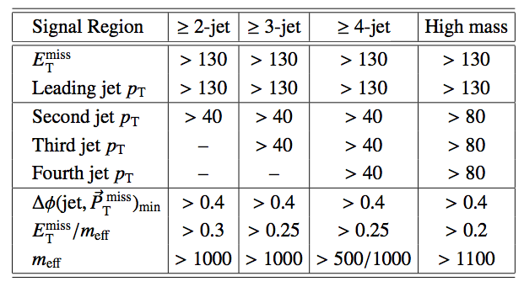
Signal Regions
Signal Region selections designed for sensitivity to specific topologies / classes of models
Large n_{jet} focuses on gluino-dominated / high m₀ (CMSSM/MSUGRA) models
Low n_{jet} sensitive to squark-dominated / low m₀ models
4-jet M_{eff}>500 GeV SR targets low mass-splitting models

Slide 8
Signal Regions
MET and leading jet p_{T} cuts protect against trigger turn-on
‘Effective mass’ scalar sum of jet p_{T} and MET
  Number of jets used differs between SRs
Δϕ(j,MET) cuts (leading 3 jets) reject QCD jet background where MET produced in association with a single jet
MET/M_{eff} cuts select topology where jets point away from MET

Slide 9
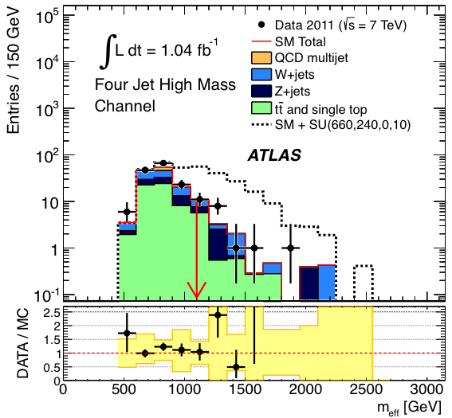
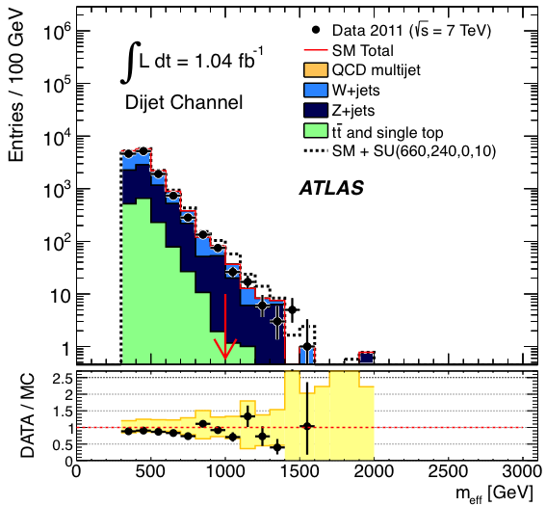
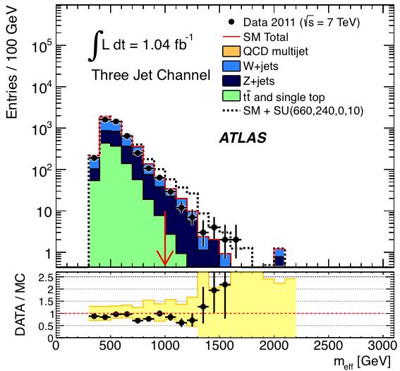
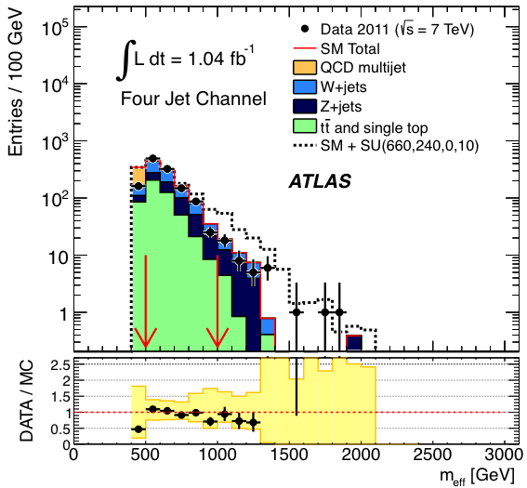
Signal Region Meff Distributions

Slide 11
Background Estimation
SM backgrounds estimated using background-enriched data control regions (CR), with MC (ALPGEN or MC@NLO) or data-driven ‘transfer factors’ (TF) used to translate to signal regions (SR)
Correlations between CR’s from cross-contamination of backgrounds taken into account with CR-SR TFs.
Backgrounds in SR obtained from coherent likelihood fit to CR observations, taking into account correlated (e.g. JES) and uncorrelated (e.g. MC stats) TF uncertainties
Many correlated uncertainties largely cancel through use of CR/SR TF ratio (e.g. JES, PDF etc.)

Slide 12
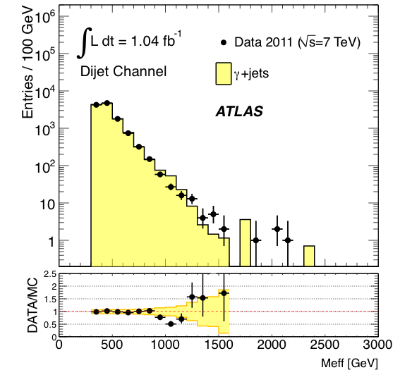
CR1a: Z+Jets Background
Estimated with two independent CRs
CR1a selects γ+jets events and adds γ p_{T} to MET to simulate Z(→υυ) + jets events
TF obtained from first principles using corrections for photon acceptance, efficiency etc.

Slide 13
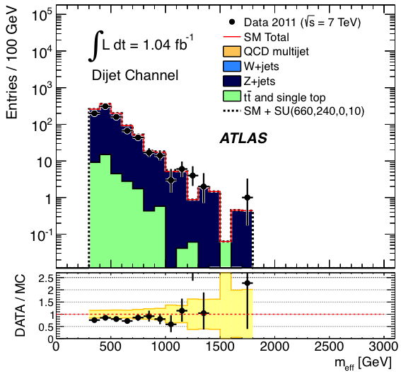
CR1b: Z+Jets Background
CR1b selects Z(→ee/μμ)+jets events and adds leptons to MET to model Z(→υυ)+jets
SR MET/Meff, Δϕ(j,MET) cuts and Meff cuts relaxed to increase acceptance (except for 4-jet M_{eff}>500 GeV SR)
TF calculated using ALPGEN with theoretical and experimental systematics estimates
Z(→ll)+jets SR background also taken into account in TF
Both CR1a and CR1b constraints used in likelihood function

Slide 14
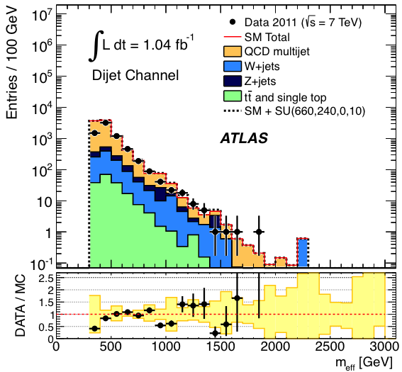
CR2: QCD Jet Background
Require Δϕ(j,MET)<0.2 to create QCD jet dominated region
TFs obtained by smearing p_{T} of jets in low MET ‘seed’ events using jet response function
Jet response function baseline obtained from MC jet truth/reco comparison
Gaussian part modified to match data jet p_{T} asymmetry distribution in dijet events
Tail modified to match MET distribution in data 3-jet ‘Mercedes’ events

Slide 15
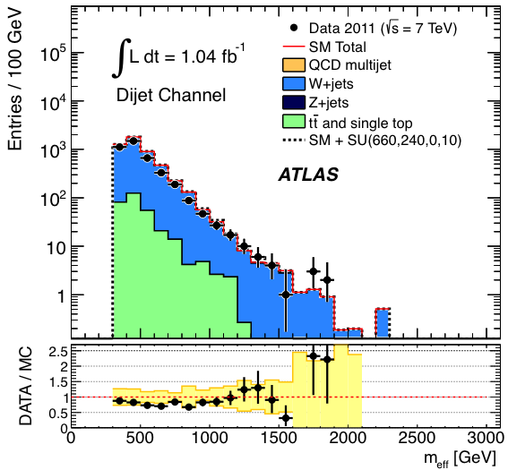
CR3: W+Jets Background
1-lepton + MET sample selected with 30 GeV < M_{T}(l,υ) < 80 GeV requirement
b-jet veto applied to separate from top control regions
Lepton treated as jet (i.e. not added to MET): models approximately hadronic tau faking jet
TFs calculated using ALPGEN with theoretical and systematic uncertainties estimates

Slide 16
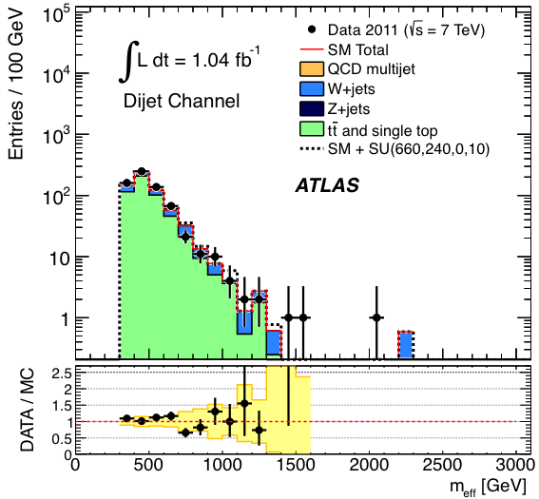
CR4: Top Background
1-lepton + MET sample selected with 30 GeV < M_{T}(l,υ) < 80 GeV requirement
b-jet requirement applied to separate from W+jet control regions
Lepton treated as jet (i.e. not added to MET): models approximately hadronic tau faking jet
TFs calculated using ALPGEN with theoretical and systematic uncertainties estimates

Slide 17
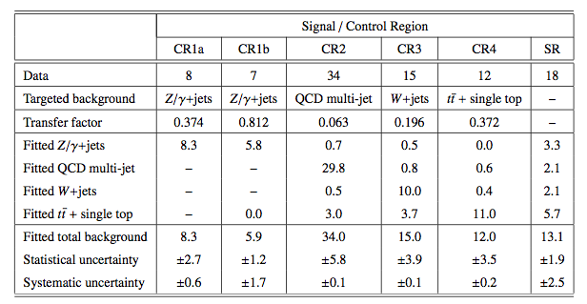
Transfer Factors
Example for ‘high mass’ signal region

Slide 18
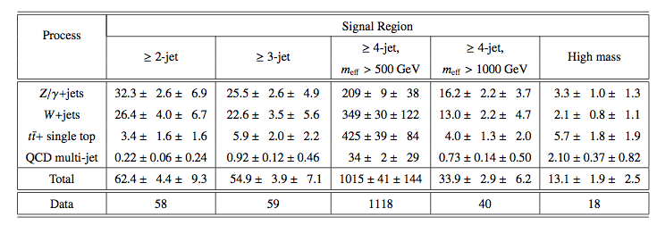
Results
No evidence of excess
Set limits in model planes, taking into account background and signal systematics

Slide 19
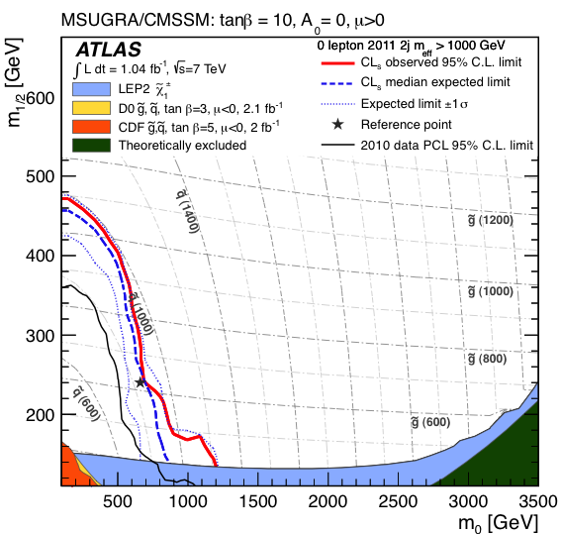
mSUGRA/CMSSM Limits

Slide 20
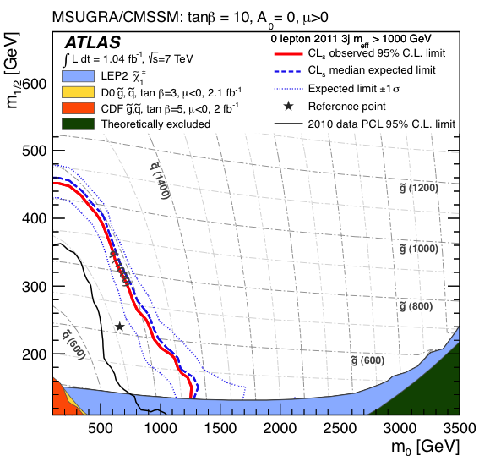
mSUGRA/CMSSM Limits

Slide 21
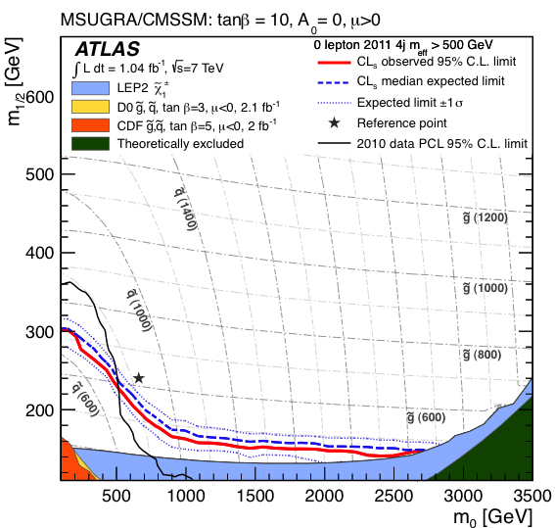
mSUGRA/CMSSM Limits

Slide 22
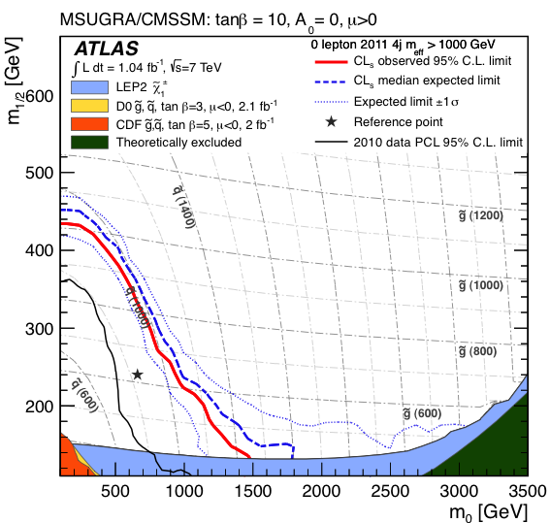
mSUGRA/CMSSM Limits

Slide 23
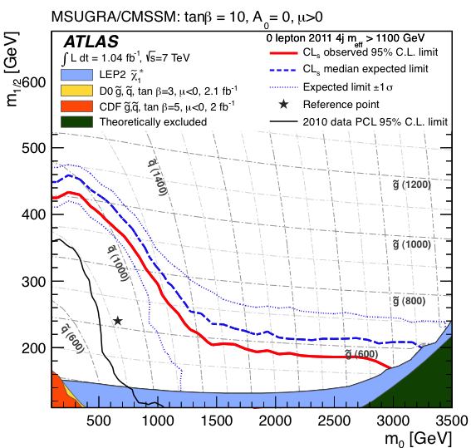
mSUGRA/CMSSM Limits

Slide 24
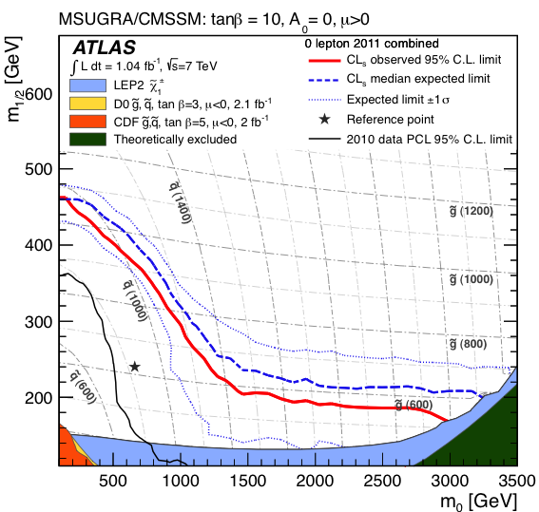
mSUGRA/CMSSM Limits

Slide 25
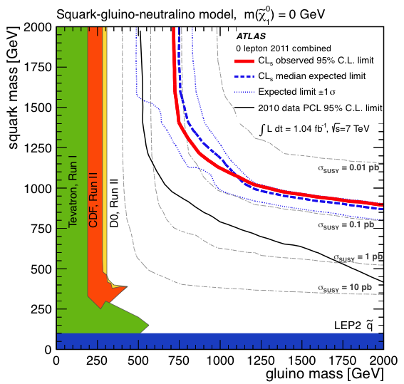
Simplified Model Limits

Slide 26
Cross-Section & Mass Limits
Additional interpretation in terms of upper limits on σxεxA for each channel
  22, 25, 429, 27 and 17 fb
Alternative models can be checked by reproducing analysis applied to signal model
Gluino (squark) masses below 700 (875) GeV excluded for squark (gluino) masses below 2 TeV and light LSP (m<200 GeV)
Gluino/squark masses below 1075 GeV excluded for equal masses and light LSP(m<200 GeV)
In mSUGRA / CMSSM degenerate mass limit ~ 950 GeV

Slide 27
Dutta: “Discovering SUSY should not be a problem!”

Slide 28
Back-up

Slide 29

>3000 physicists
38 countries
175 institutes
~300 UK
14 institutes

Slide 30
Liquid Argon Calorimeter

Slide 31
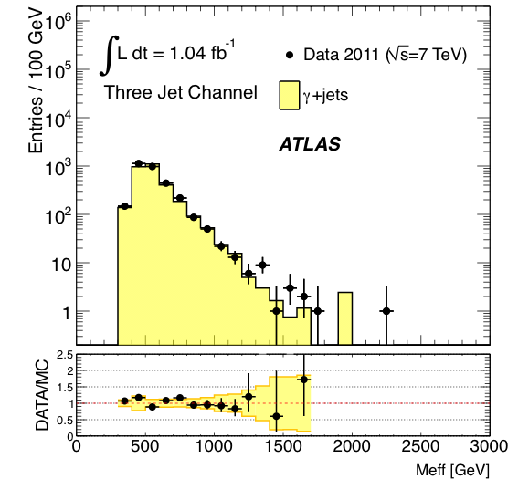

Slide 32
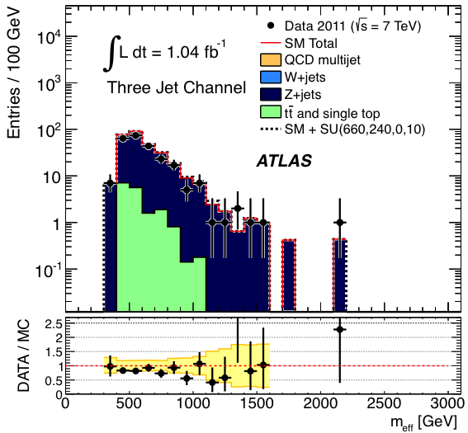

Slide 33
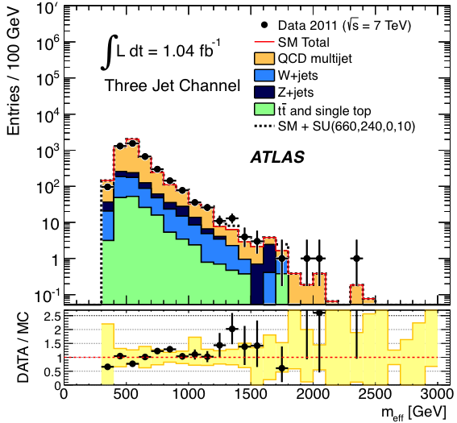

Slide 34
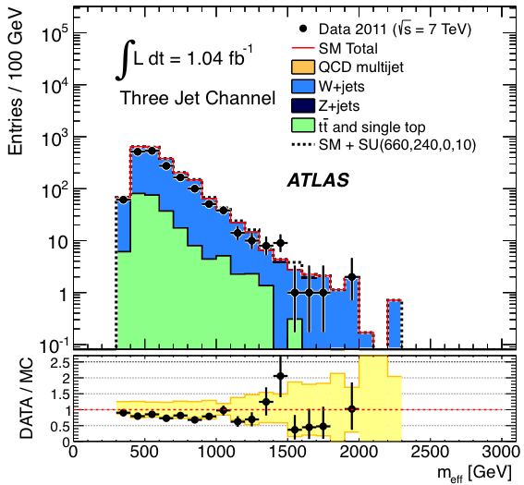

Slide 35
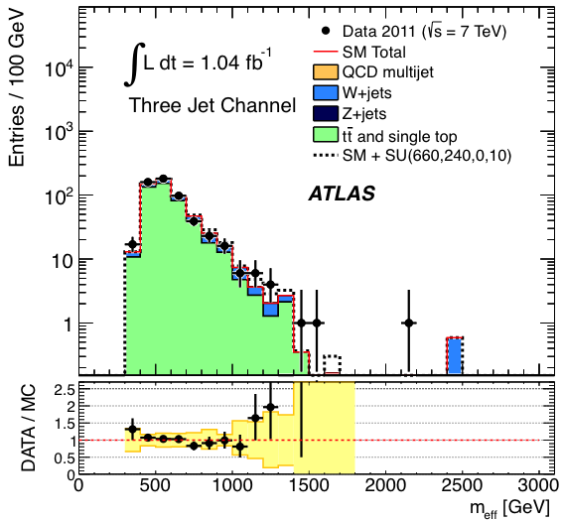

Slide 36
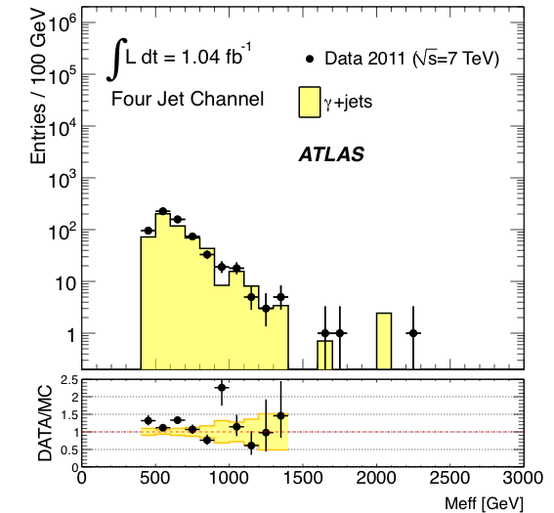

Slide 37
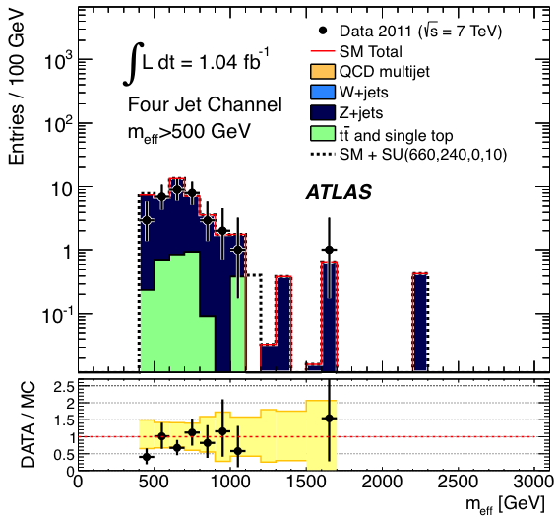

Slide 38
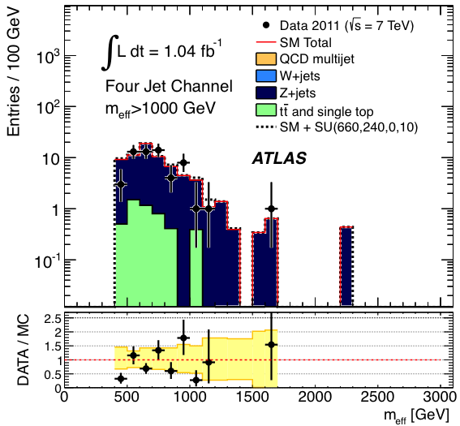

Slide 39
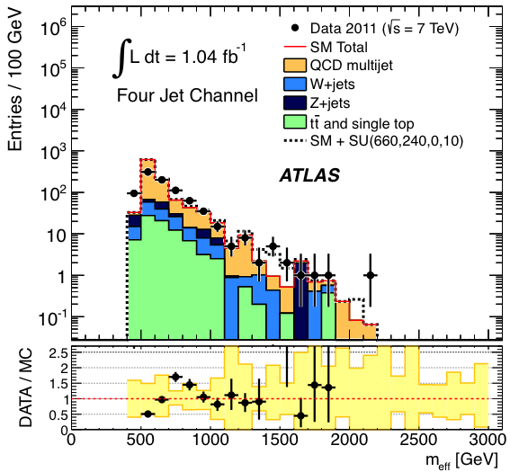

Slide 40
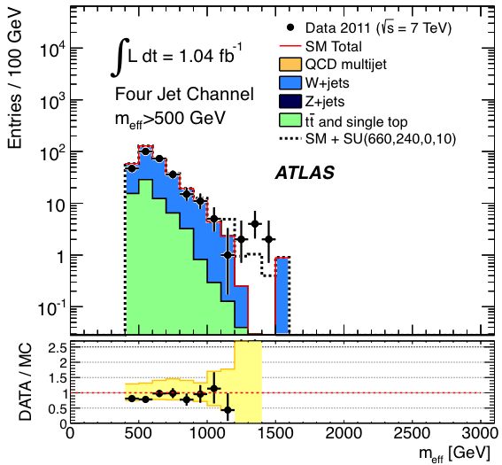

Slide 41
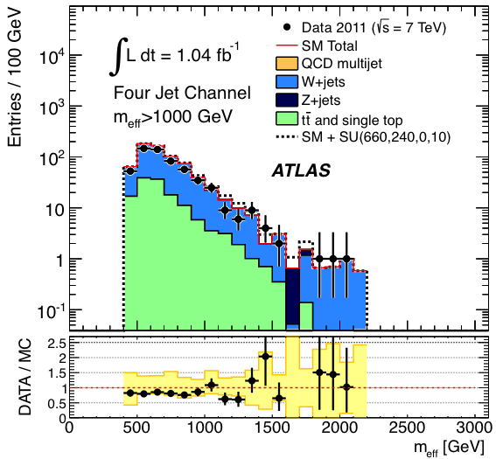

Slide 42
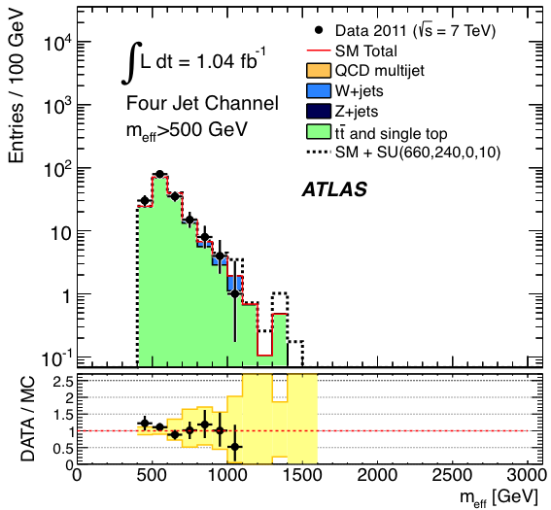

Slide 43
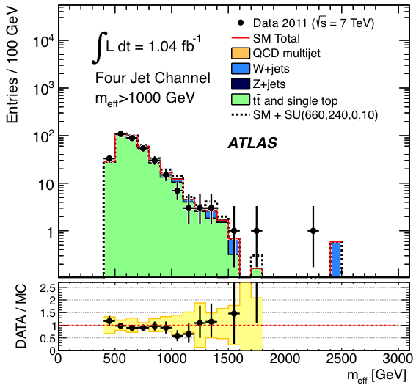

Slide 44
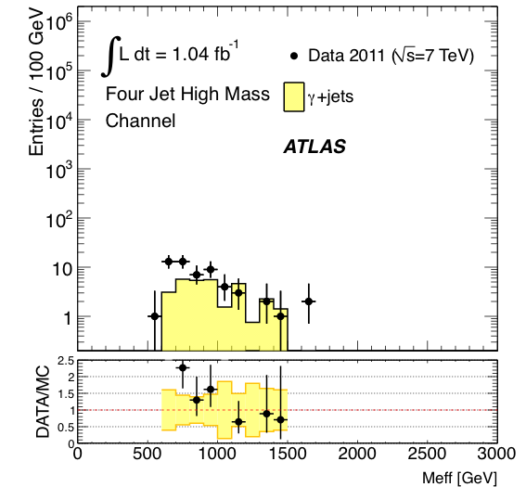

Slide 45
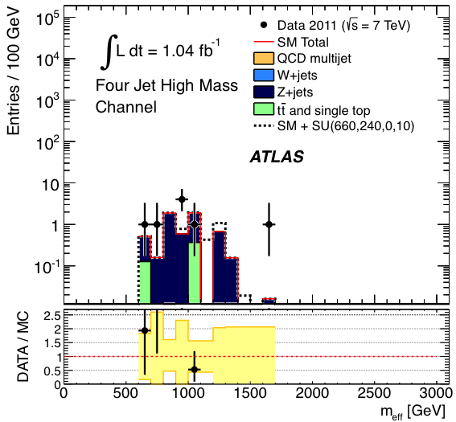

Slide 46
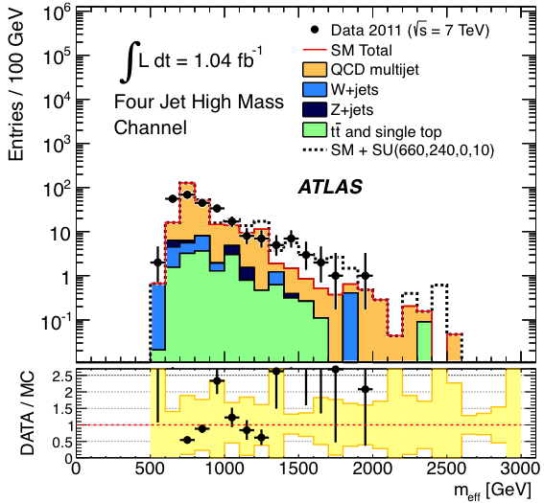

Slide 47
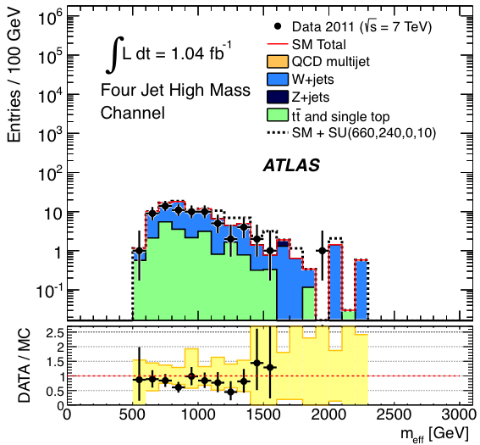

Slide 48
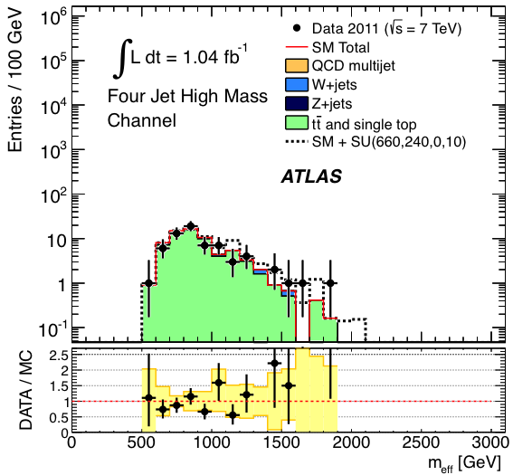

Slide 49
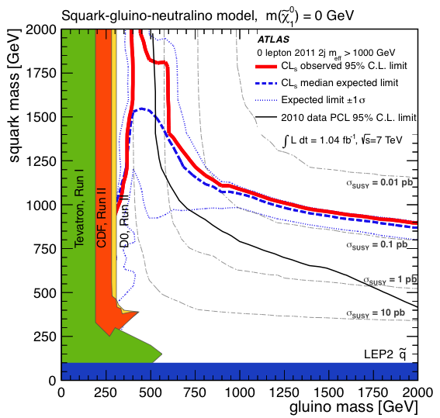

Slide 50
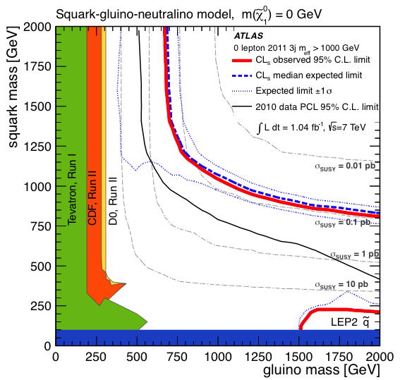

Slide 51
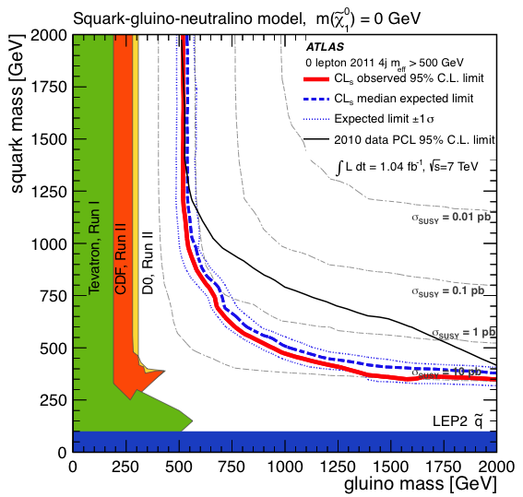

Slide 52
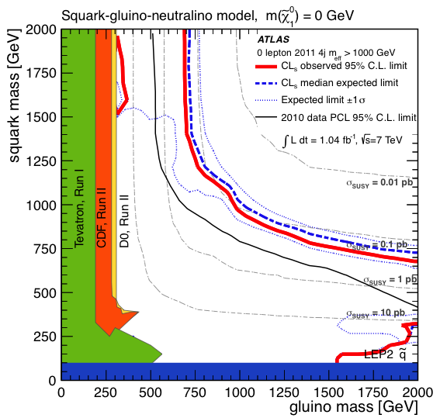

Slide 53
