Slide 1

Spherical Collapse in Chameleon Models
Work done with Ph. Brax and D. Steer (JCAP 2010)
Rogerio Rosenfeld
Instituto de Física Teórica
UNESP
2nd Bethe Center Workshop
Cosmology meets Particle Physics

Slide 2
Chameleon: scalar field with environmental dependent properties (Khoury and Weltman 2004)
General mechanism (Damour et al. 1990)
Weyl scaling of the metric
Jordan frame
Einstein frame
Masses and couplings become space-time dependent in Einstein frame!

Slide 3
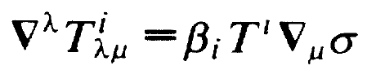
Matter energy-momentum tensor is not conserved in Einstein frame due to scalar field coupling:
Scalar field obeys a Klein-Gordon equation with an effective potential:

Slide 4
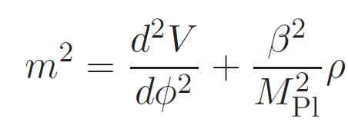


Mass of scalar field depends on the dark matter density:
Relevant for mR<1 in order to modify the evolution of structure.
Chameleon coupling changes perturbed metric:
Matter follows an effective gravitational perturbation:

Slide 5
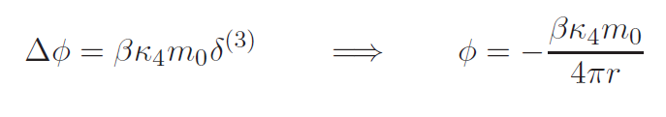
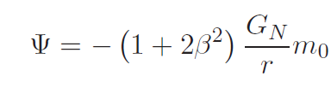
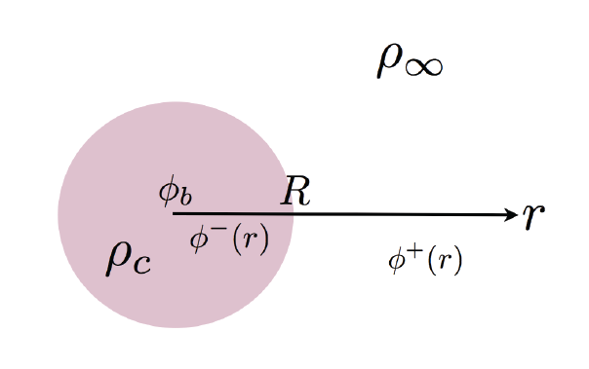
Modification of gravity for a point mass and V=0:
Must study chameleon profile in spherical structures with time-dependent radius and density

Slide 6
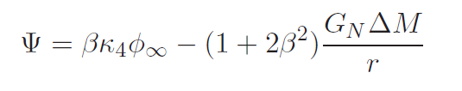

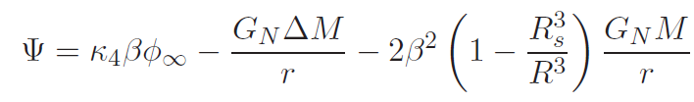
For small bodies:
similar to the point-like mass case.
For large bodies the field remains constant in an inner region of radius R_{S} above which it relaxes in a shell to the background value resulting in:

Slide 7
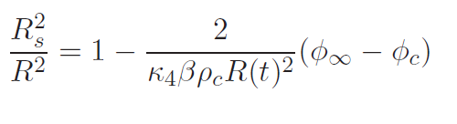
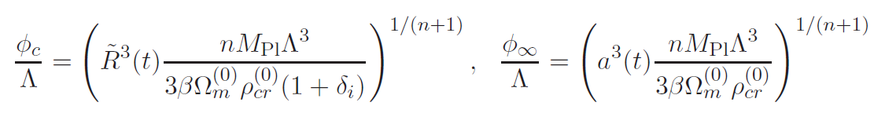
The radius R_{S} is determined by the continuity of the field in R and is given by:
and is model-dependent (depends on the scalar potential).
Inverse-power-law potential:

Slide 8
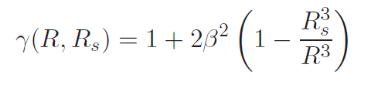
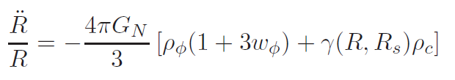
The usual newtonian potential gets modified by a factor (thin shell effect)
GR (β=0 or R_{S} =R , γ=1); small body (R_{S} =0)
Modified acceleration equation:
Caveats (ok for thin shells):
density remains uniform
no shell crssing

Slide 9
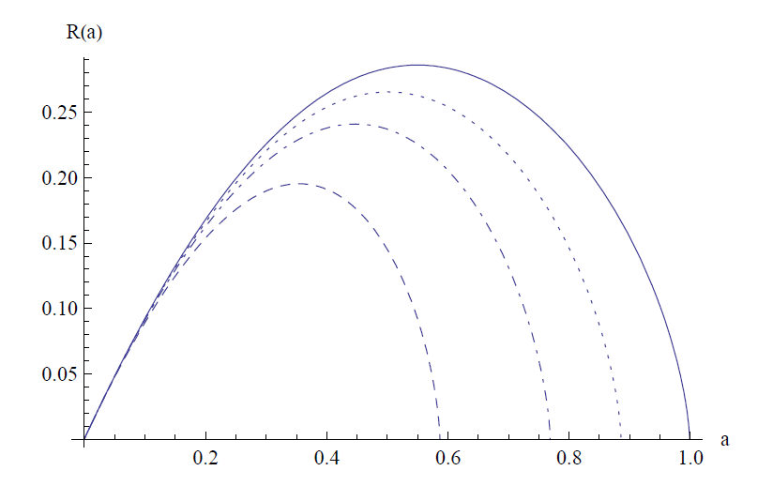
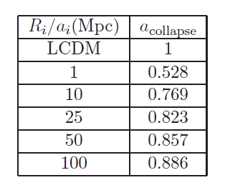
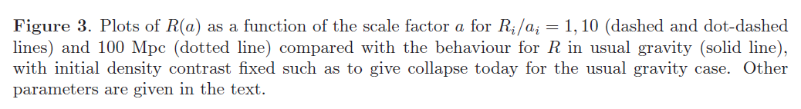
Initial conditions chosen for collapse today in LCDM.

Slide 10
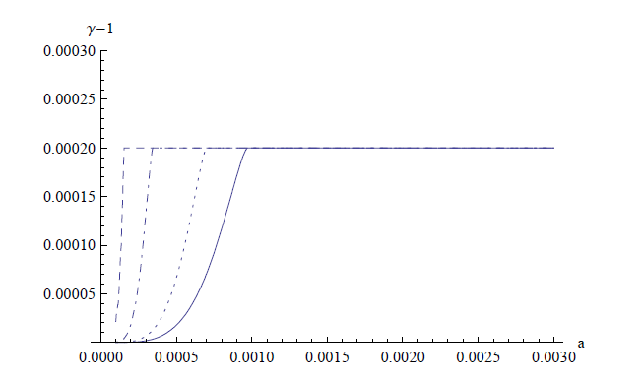
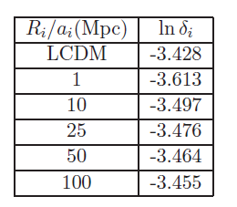
Shells disappear quickly:
Initial density contrasts for chosen for
collapse today

Slide 11
Conclusions
Initial study on the influence of chameleons in the nonlinear regime of spherical collapse, including thin shell effect;
Collapse depends on size of initial perturbation;
Moving barrier problem for structure formation;
Must understand full dynamics beyond the simple approximation used here: nonuniform densities, shell crossing, etc.

