Slide 1
Desertec

Slide 2
Outline
What and who is Desertec?
Power Plants Overview
Solar irradiation in EUMENA
Concentrating solar power (CSP) Power Plant
Energy Transportation
Advantages and Problems of Desertec

Slide 3
What and who is Desertec?
a global civil society initiative aiming to shape a sustainable future
formed of scientists, politicians and economists

Slide 4
What and who is Desertec?
a global civil society initiative aiming to shape a sustainable future
formed of scientists, politicians and economists
What do they do?
inform society and politicians
promote establishment of framework conditions
support knowledge transfer
foster exchange and co-operation

Slide 5
What and who is Desertec?
a global civil society initiative aiming to shape a sustainable future
formed of scientists, politicians and economists
What do they do?
inform society and politicians
promote establishment of framework conditions
support knowledge transfer
foster exchange and co-operation
What is the concept?
choosing the best locations for renewable energy production
transport it to the places of demand

Slide 6
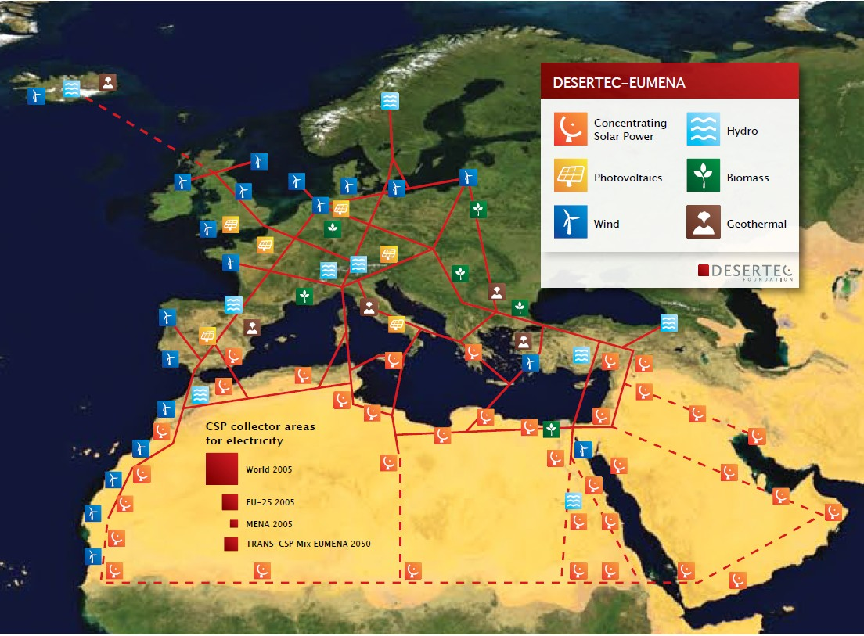
Eurpoean-Union-Middle-East-North-African (EUMENA) Concept

Slide 7
Power Plants Overview
Power Plant (renewable) | Energy properties
Wind Power | weather fluctuations
Photovoltaic | seasonal and weather fluctuations (just in Europe) expensive
Biomass | seasonal fluctuations good storability high area demand
Geothermal | no fluctuations expensive
Hydropower | seasonal fluctuations good storability exhausted
Concentrating Solar Power (CSP) | seasonal and weather fluctuations (just in Europe) good storability expensive

Slide 8
Power Plants Overview
Power Plant (renewable) | Energy properties
Wind Power | weather fluctuations
Photovoltaic | seasonal and weather fluctuations (just in Europe) expensive
Biomass | seasonal fluctuations good storability high area demand
Geothermal | no fluctuations expensive
Hydropower | seasonal fluctuations good storability exhausted
Concentrating Solar Power (CSP) | seasonal and weather fluctuations (just in Europe) good storability expensive
→ Concentrate on CSP Power Plants

Slide 9
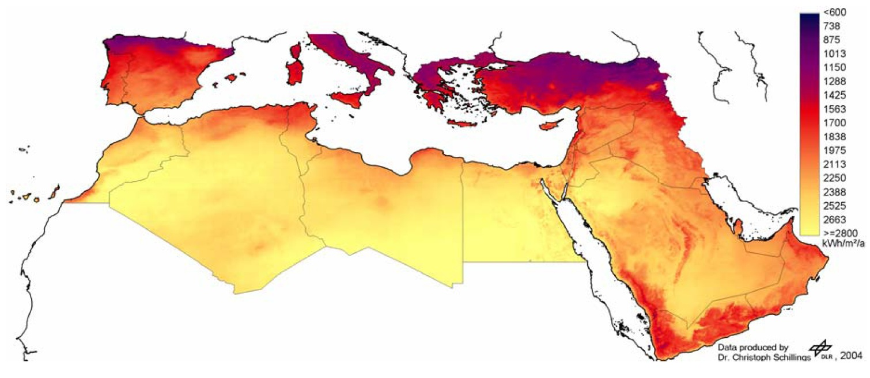
Solar irradiation in EUMENA

Slide 10
Solar irradiation in EUMENA
→ large increase toward southern countries
→ energy production a lot more efficient in North Africa

Slide 11
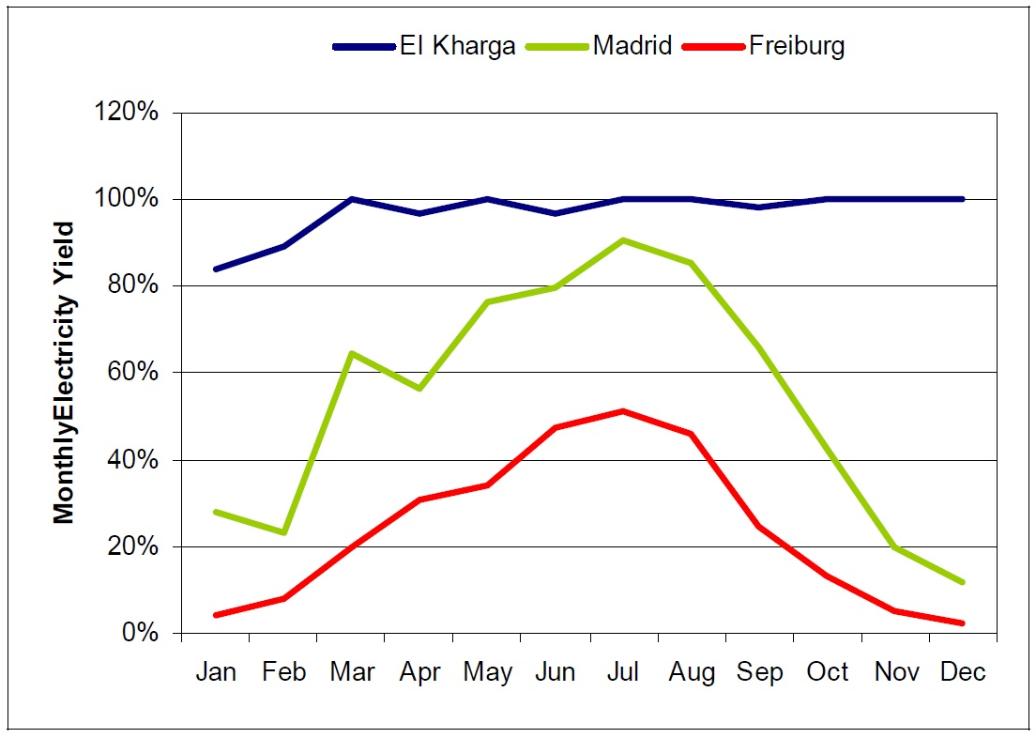
Solar irradiation in EUMENA

Slide 12
Solar irradiation in EUMENA
→ considerably less fluctuation in North Africa than in Europe

Slide 13
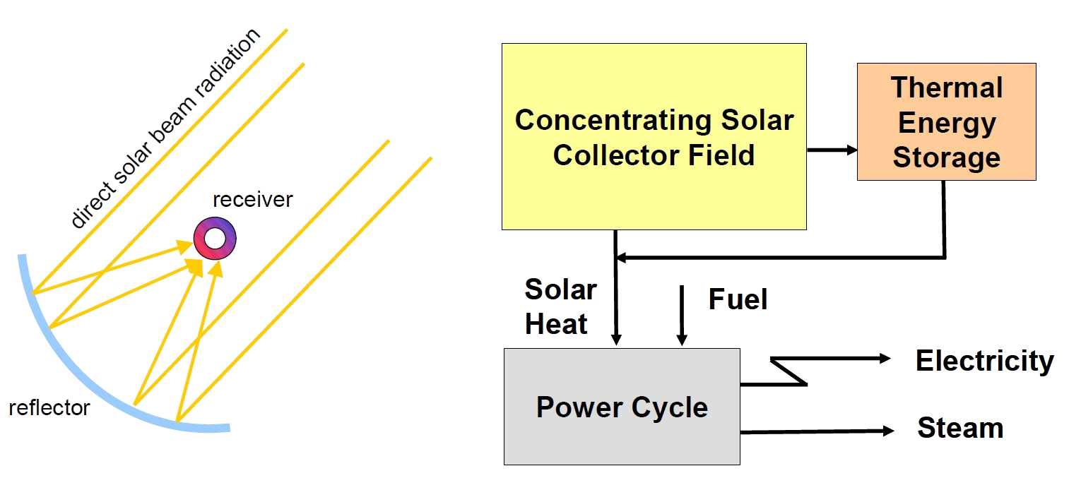
Concentrating solar power (CSP) Power Plant

Slide 14
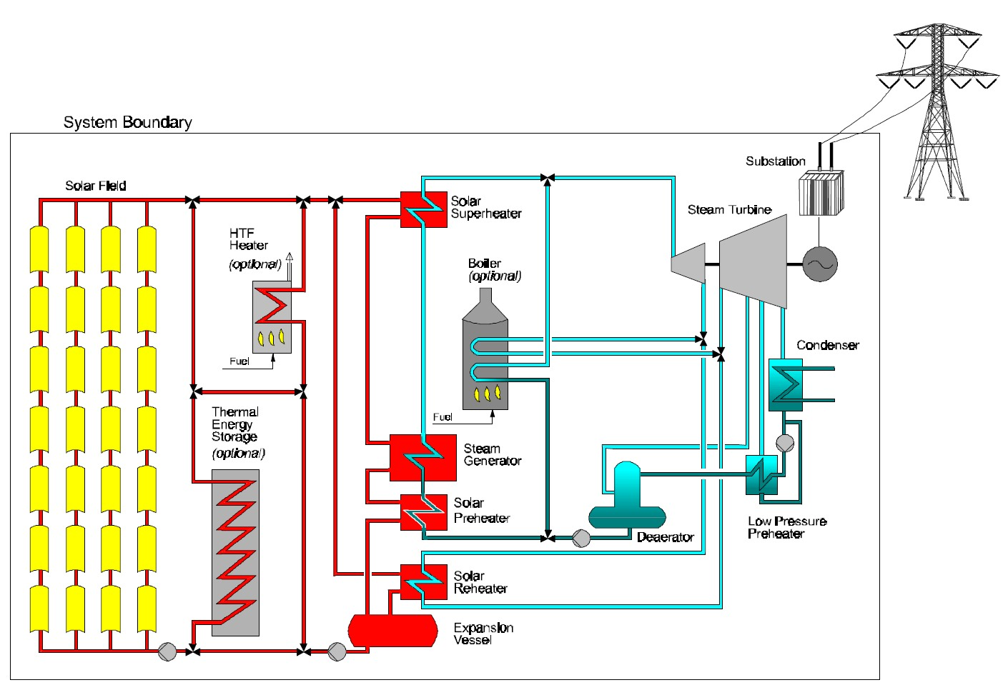
Concentrating solar power (CSP) Power Plant

Slide 15
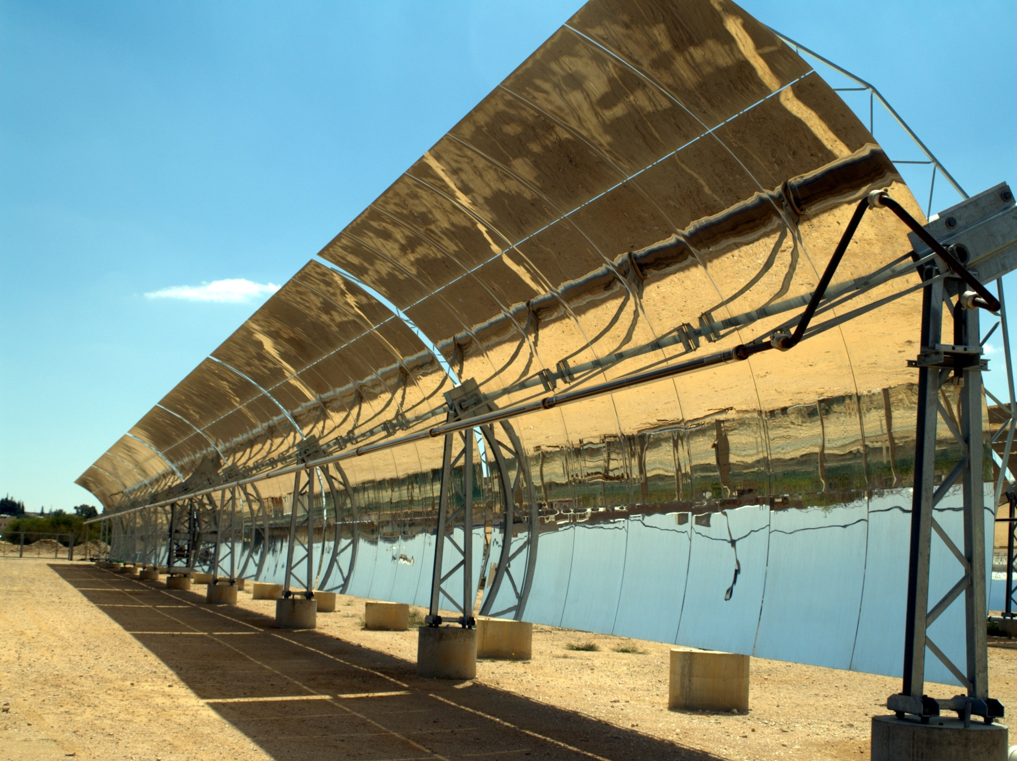
Concentrating solar power (CSP) Power Plant
Source: http://upload.wikimedia.org/wikipedia/commons/0/01/Solar_troughs_in_the_Negev_desert_of_Israel.jpg

Slide 16
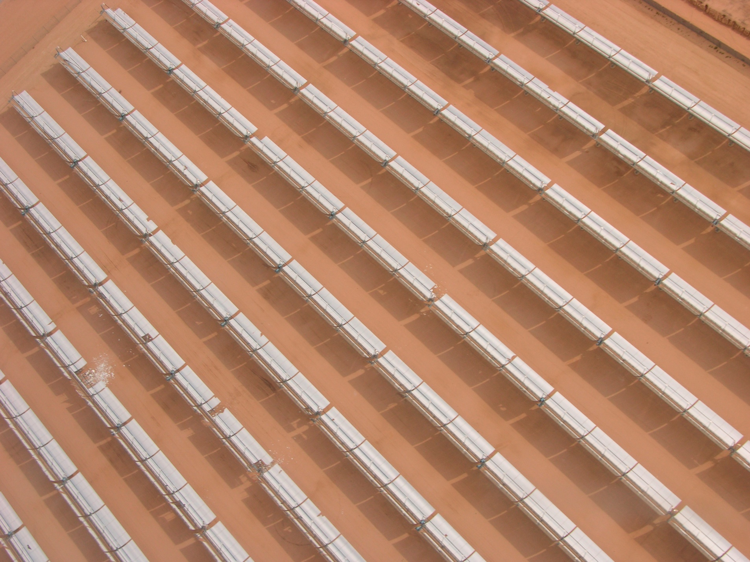
Concentrating solar power (CSP) Power Plant
Source: http://upload.wikimedia.org/wikipedia/commons/4/40/Solarplant-050406-05.jpg

Slide 17
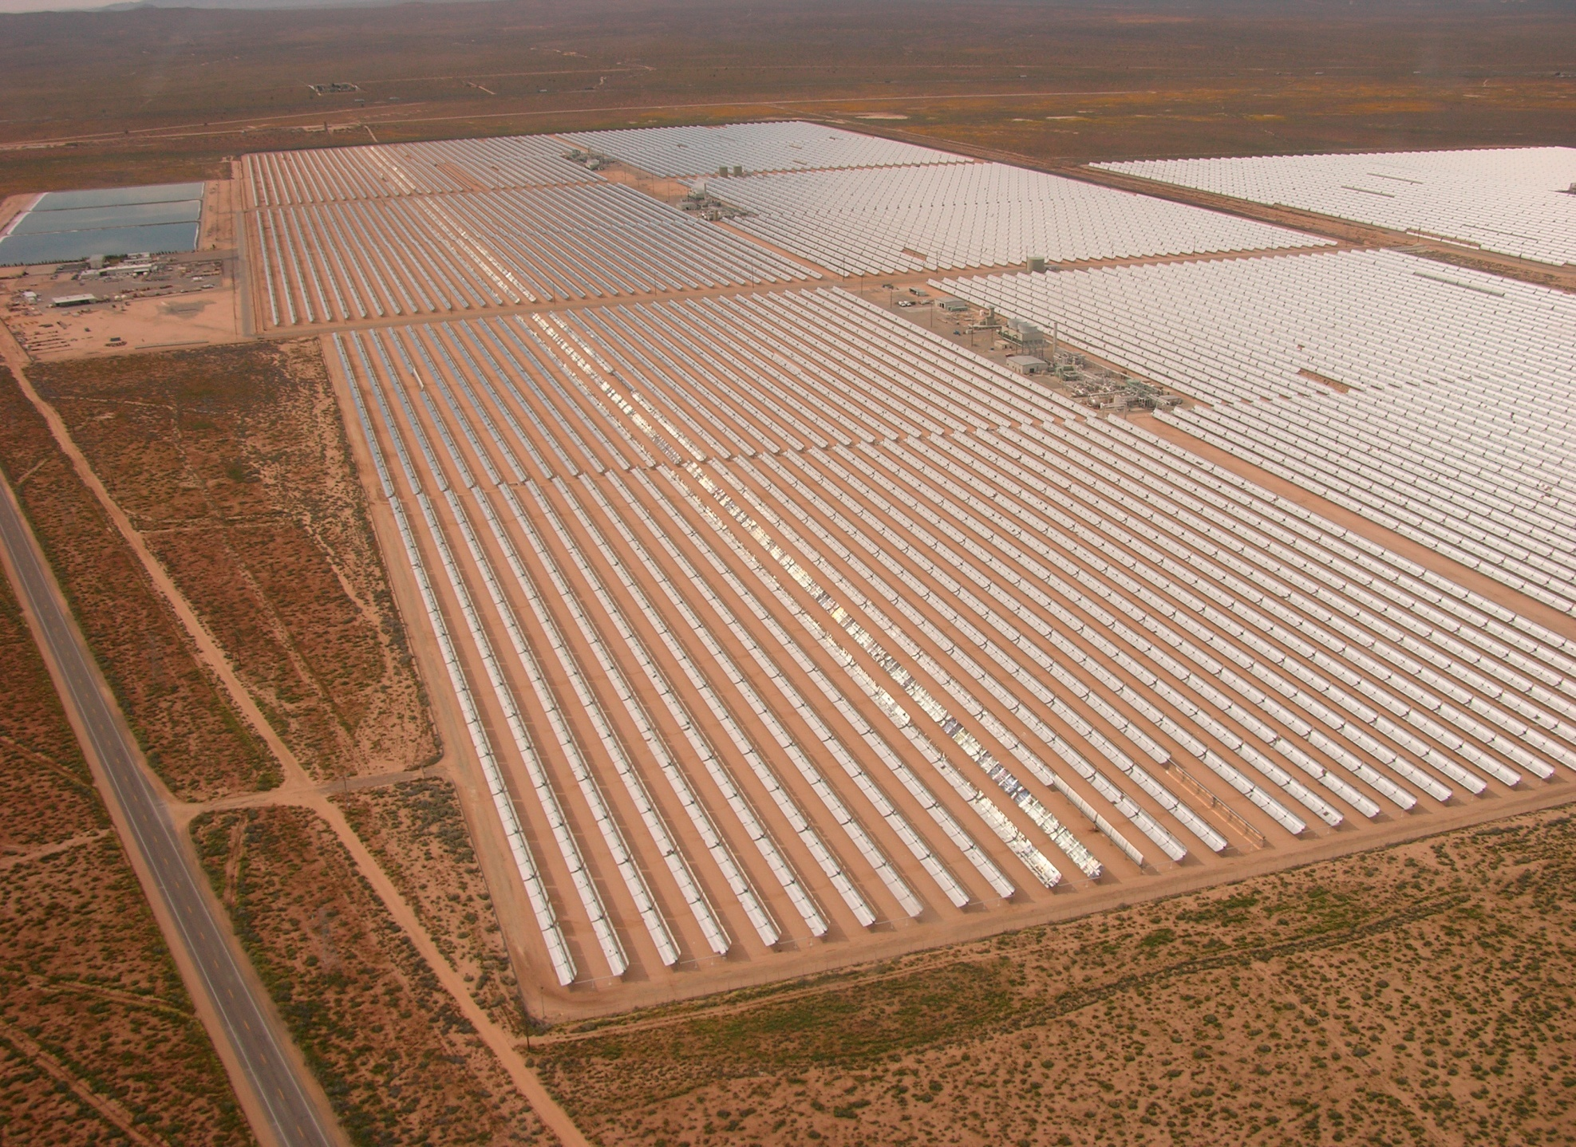
Concentrating solar power (CSP) Power Plant
Source: http://upload.wikimedia.org/wikipedia/commons/4/44/Solarplant-050406-04.jpg

Slide 18
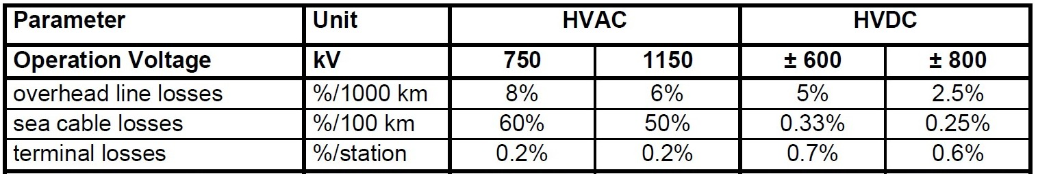
Energy Transportation
Values for transportation of 5 GW

Slide 19
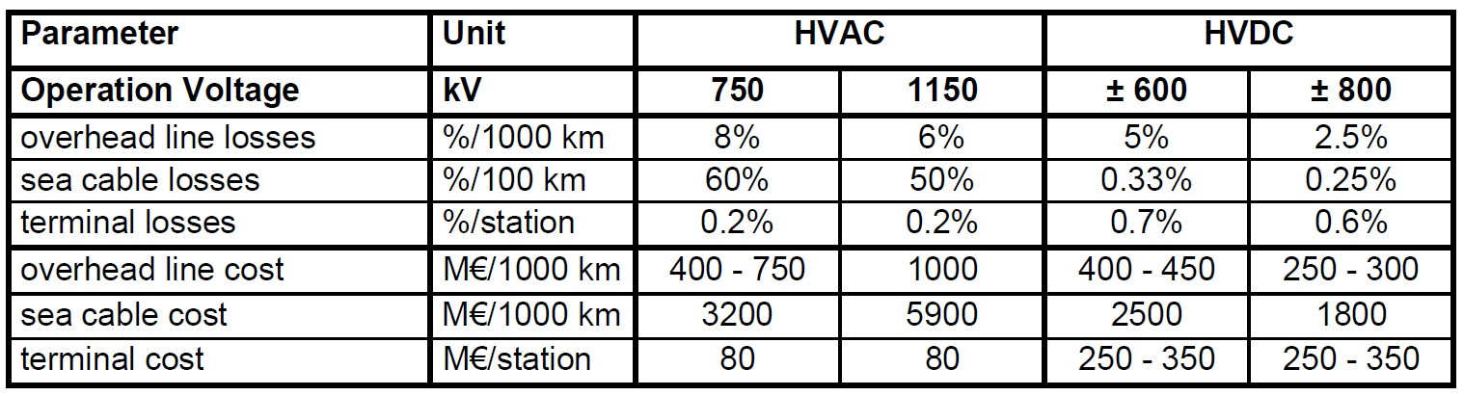
Energy Transportation
Values for transportation of 5 GW

Slide 20
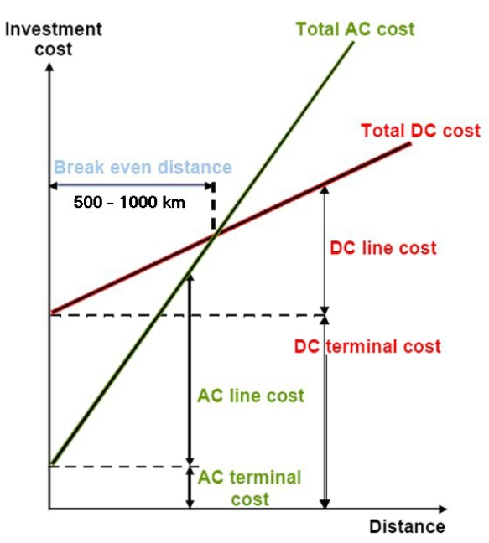
Energy Transportation

Slide 21
Energy Transportation
→ HVDC better adapted
for transporting
energy over more
than 1000 km

Slide 22
Energy Transportation
→ HVDC better adapted
for transporting
energy over more
than 1000 km
→ Summarized we get
an energy loss of
about 3% per 1000 km
for HVDC

Slide 23
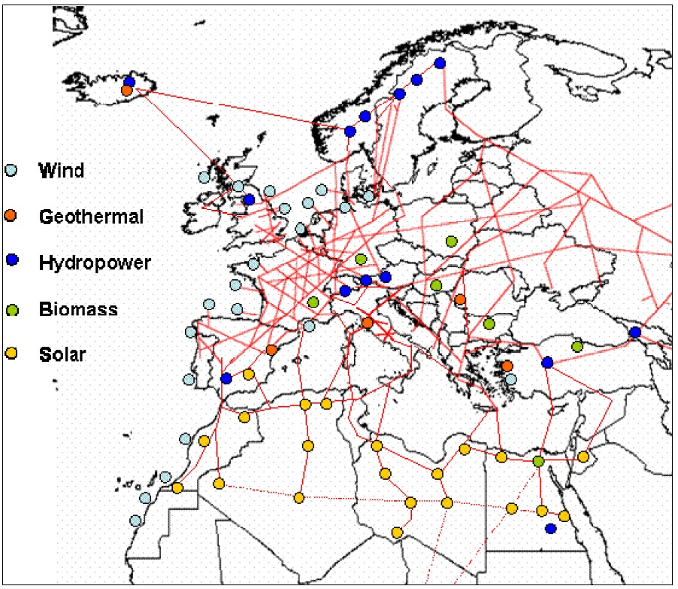
Vision of the HVDC electricity grid

Slide 24
Advantages and Problems of Desertec

Slide 25
Advantages
Reducing Emission of CO₂
Sustainable production of energy
Assuring electrical power supply for Europe
Advantages in MENA:
  Creating jobs and improving infrastructure
  Thermal desalination of sea water (CO₂-free)

Slide 26
Technical problems
Problem:
  Conditions for the mirrors of the CSPs are very hard, they have to resist UV-radiation, storms etc.
Solution:
  There is a safety position for the mirrors
Example:
  Mirrors in the Mojave desert (California) resist already for over 20 years different kinds of storms, breaking only 0,4% per year

Slide 27
Economical problems
Problem:
  The big companies involved in Desertec want to extend their monopolies
  Small companies cannot afford to join in Desertec
Counter-argument:
  Generating only 17% of the necessary energy is no monopoly

Slide 28
Economical problems
Problem:
  Instead of investing the money in MENA there can be achieved much more in Europe
Counter-argument:
  The Energy that can be generated in Europe isn’t enough to cover the consumption
  Especially to compensate the seasonal fluctuations

Slide 29
Economical problems
Problem:
  Who pays for it?
  Generating power with CSPs is not profitable in comparison to conventional possibilities
    Not many investors are interested at the moment
    The involved companies are able to afford only about 30% of the costs
  It is not possible to schedule such a big project properly or to estimate the costs correctly

Slide 30
Political problems
Problem:
There are to many involved parties
Every state will try to take advantage, so there will be much resistance in MENA
  Ruling parties primarily want to keep their power (especially family clans)
  They don’t care for the progress of the economy
Due to the Arab Spring the situation may have changed in a good or bad way

Slide 31
Political problems
Problem:
Importing too much energy will create political dependencies
Counter-argument:
  Since the energy will be supplied from many states the problem of political dependencies will decrease
  Europe is already dependent (Russian-Ukrainian gas conflict)
  Europe is already importing oil and gas from Algeria and Libya

Slide 32
Risk of terroristic assaults
  Solution:
  Only 17% of the necessary energy will be imported
  There will still exist back-up power plants for compensating the fluctuations of renewable energy sources
  So it will be possible to compensate the missing energy for a while
  Economic progress and better education decrease this risk

Slide 33
Summary
Desertec is a concept to solve the energy problem in the world
It concentrates on the production of energy in the most efficient places
(mostly deserts)
CSP power plants in North Africa are very suitable to produce a large
part (app. 17 %) of the European energy demand in the future
The transportation takes place via HVDC, which has a loss rate of about
3% over 1000 km
Investment costs for an EUMENA HVDC energy grid are high
From the technical point of view there are no big problems
Political situation in MENA very unclear and not predictable
Not profitable yet, not enough Investors

Slide 34
Thank you for your attention!

Slide 35
Sources
Trans-CSP study: http://www.dlr.de/tt/Portaldata/41/Resources/dokumente/institut/system/projects/TRANS-CSP_Full_Report_Final.pdf
Desertec Foundation: http://www.desertec.org/
SolarPaces: http://www.solarpaces.org/inicio.php
http://www.welt.de/print/wams/vermischtes/article13726066/Stromoase-in-der-Sahara.html
http://www.manager-magazin.de/unternehmen/energie/0,2828,635955,00.html
http://www.dw-world.de/dw/article/0,,15538574,00.html
http://www.stern.de/wissen/natur/desertec-startschuss-fuer-wuestenstrom-projekt-706083.html
http://de.wikipedia.org/wiki/Desertec

Slide 36
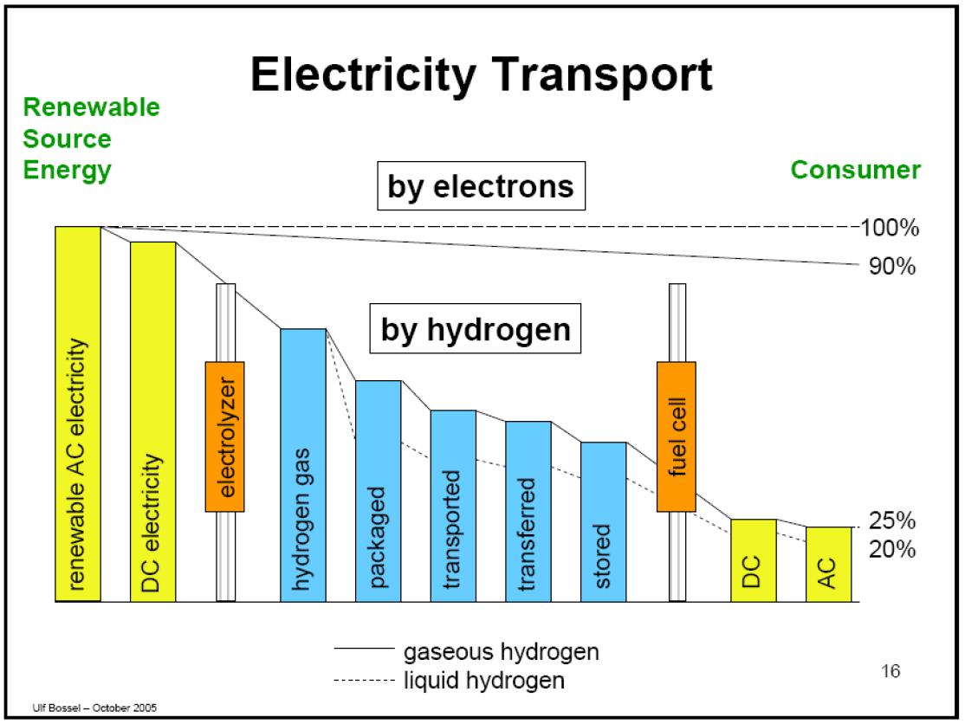
Why not use hydrogen to transport energy?

