Slide 1
Electric Cars
13.12.2011
Elena Zarkh
Jasmin Merzel
Jonathan Ottnad

Slide 2
Overview
Historical Introduction
Concept of Electric Cars
Batteries, engine and brakes
CO2-savings
Monetary savings
Infrastructure
Future development
Conclusion

Slide 3
Historical introduction
1672 first automobile (steam engine, Ferdinand Verbiest )
1828 first electric car model, Ányos Jedlik
Between 1832-1838 first electric carriage, R. Anderson
1842 first electric car with a non-rechargeable
electric cell, Thomas Davenport and Robert Anderson
1885 the first car with four-stroke circle gasoline engine, Karl Benz
1891 first electric car that actually worked, A. L. Ryker and W. Morrison
Notes:
1920: electric cars had to competite with petroleum-fueled cars

Slide 4
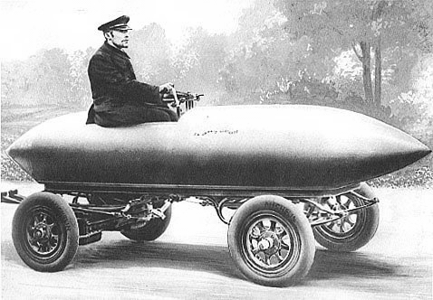
Historical introduction
1897 first commercial application
1899 first world speed record of 105 km/h
Camille Jenatzy in his car Jamais Contente,
Top speed of 105.88 km/h on April 29, 1899
www.wikipedia.org
Notes:
1920: electric cars had to competite with petroleum-fueled cars

Slide 5
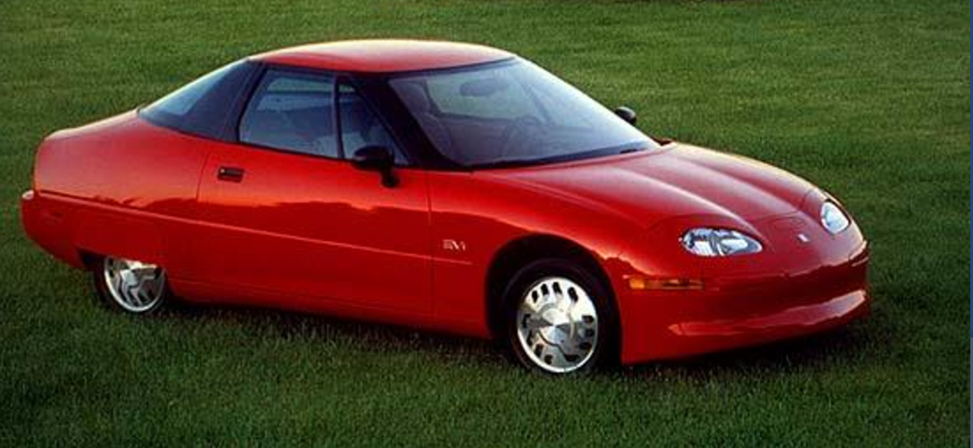
Historical introduction
1935 practically disappeared
The energy crisis in the 1970’s and 80’s revivals the interest
In the 90’s high interest for the “emissions free vehicles”:
  New technologies in electric car industry
  The topic of the environment pollution is still relevant

Slide 6

Historical introduction
Eliica vs. Porsche 911 Turbo:

Slide 7
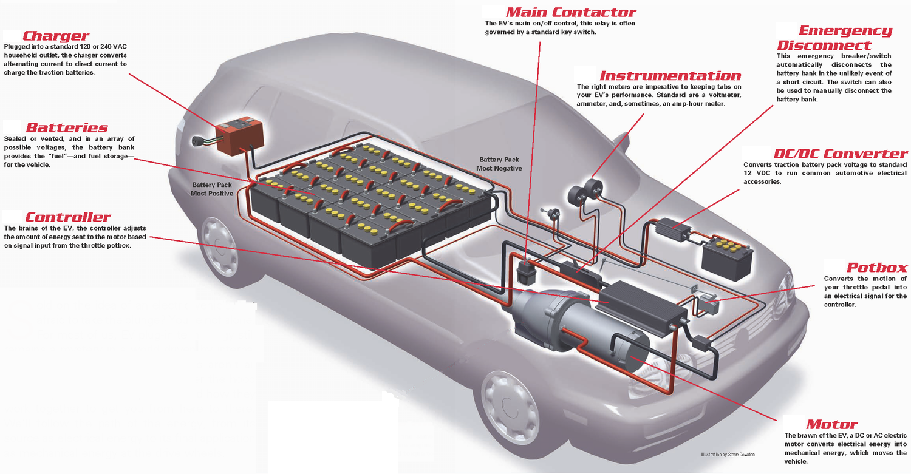
Concept of electric cars
http://www.electronica.mkg

Slide 8
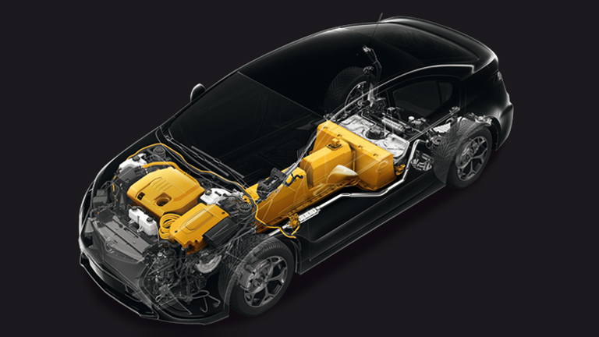
Concept of range extended electric car
www.opel.de
Notes:
Rein elektronischer range: 60 km

Slide 9
Batteries, engine and brakes
Battery types:
→ 24 kWh Lithium-ion Battery: 190 kg, 8400 €
 | Cost per Wh | Wh / kg | Wh / liter
Lead-acid | 0.13 € | 41 | 100
Nickel-metal | 0.72 € | 95 | 300
Lithium-ion | 0.35 € | 128 | 230

Slide 10
Batteries, engine and brakes
Engine types:
AC-Induction
DC-Brushes
Both types can be:
Wheel-hub-engine
Direct-drive-engine

Slide 11
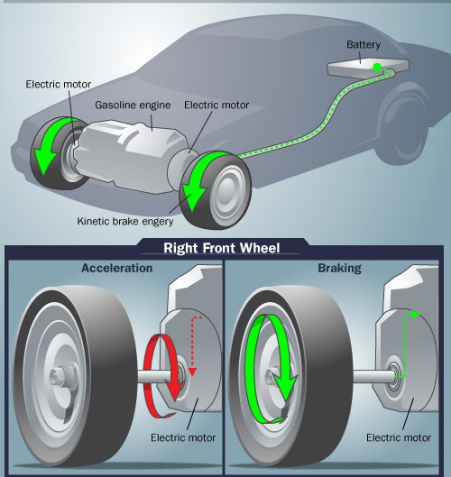
Batteries, engine and brakes
Brakes:
Regenerative brake
Can extend range up to 30%
Useful for stop&go
www.electric-car-abc.com

Slide 12
CO2-savings
CO2-emission of fossile-energy powered vehicle: about 160 g/km (average mid-class car)
What causes the emission of an electric car?
  →The production of energy used to charge the electric car
Where does this energy come from?

Slide 13
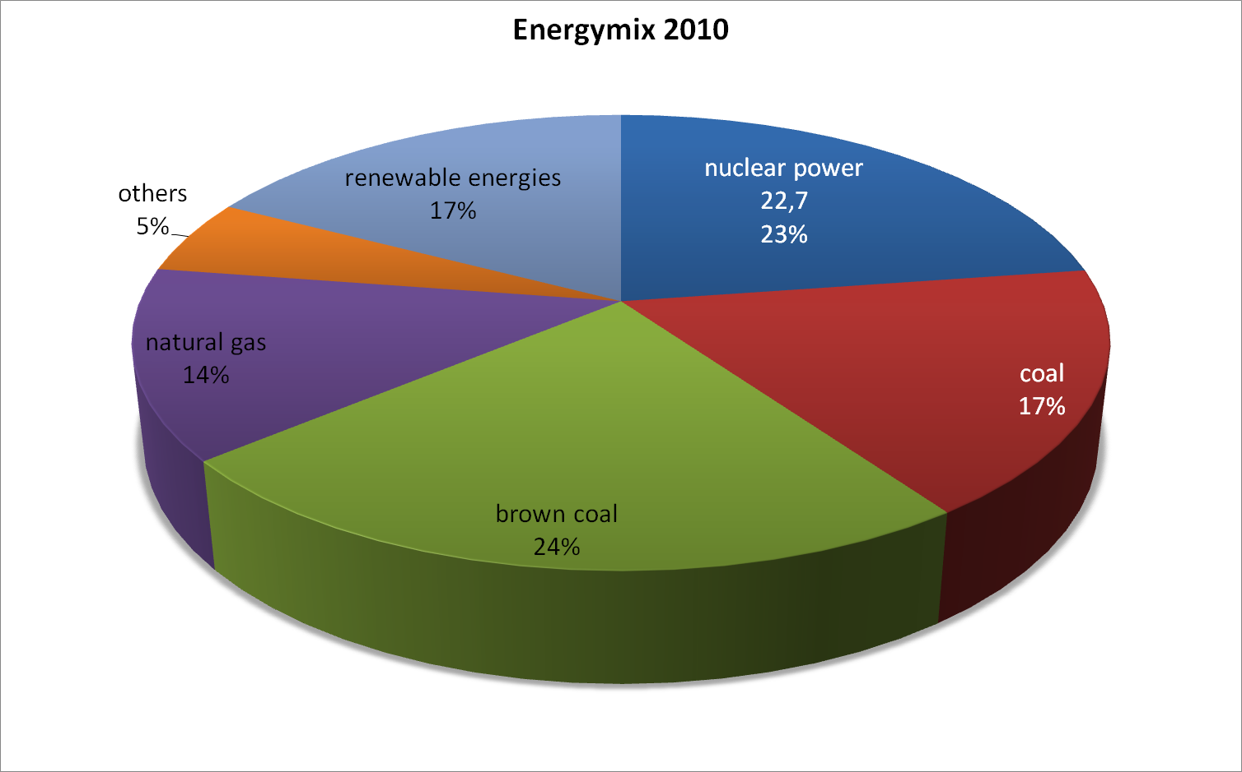
CO2-savings
→ 563 g/kWh CO2-Emission

Slide 14
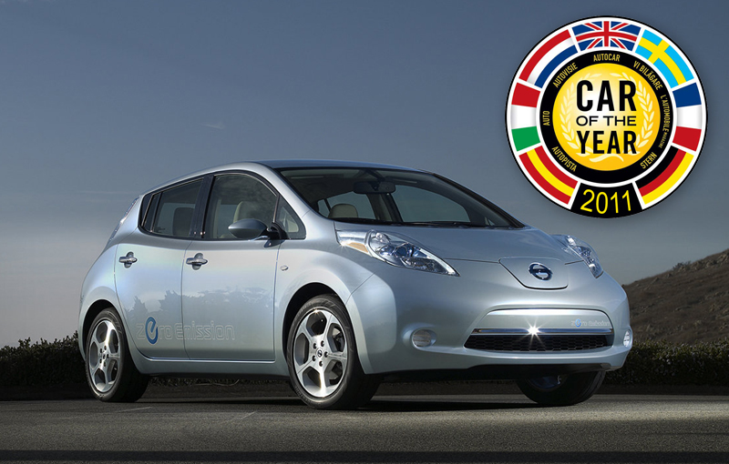
CO2-savings
How much energy does a electric vehicle need?
Nissan Leaf:
range: 175.5 km
engine power: 80 kW
max. speed: 140 km/h
battery capacity: 24 kWh
charging efficiency: 85%
→ 0.161 kWh/km
→ 90.58 g/km
http://www.car-addicts.com

Slide 15
CO2-savings
Comparison to other latest electric vehicles:
 | Ford Focus Electric | Chevrolet Chevy Volt* | Mitsubishi i-MIEV | Smart ED
release date | 2012 | 2011 | 2010 | 2009
engine power | 92 kW | 111 kW | 49 kW | 30 kW
max. speed | 135 km/h | 161 km/h | 130 km/h | 100 km/h
battery capacity | 23 kWh | 16 kWh | 16 kWh | 16.5 kWh
range | 160 km | 80 km | 150 km | 135 km
CO2 / km | 95 g/km | 132 g/km | 71 g/km | 81 g/km
Notes:
92 kW = 125 PS

Slide 16
Monetary savings
Nissan Leaf vs. Nissan Micra:
Average price of 1 liter fuel: 1.52 €
Average price of 1 kWh: 0.17 €
Batteries need to be exchanged after some time
 | Leaf | Micra
engine power | 80 kW | 72 kW
max. speed | 140 km/h | 180 km/h
consumption | 0.161 kWh/km | 0.05 l/km
costs per 100 km | 2.74 € | 7.60 €
price | 37 000 € | 13 000 €

Slide 17
Infrastructure
Are there enough charging stations?
Can the existing energy production and energy grid cover the arising demand?
What can one do if running out of energy on a trip?

Slide 18
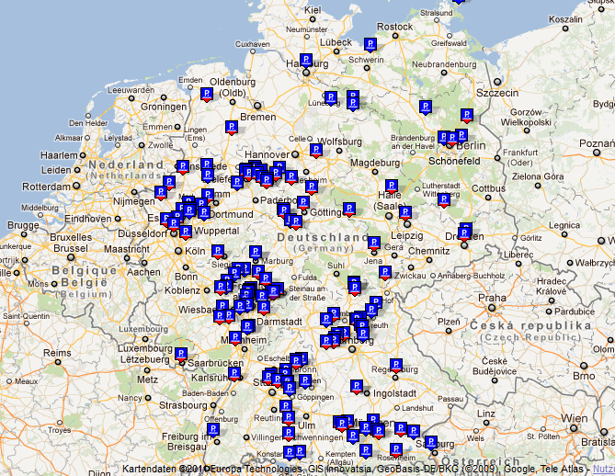
Infrastructure
Charging stations:
All vehicles can be charged at home
More than 2200 charging stations all over Germany
www.lemnet.org

Slide 19
Infrastructure
Let us assume a homogenous density of charging stations
Area of Germany: ~ 360 000 km²
→1 charging station / 167 km²
Divide Germany in square areas of 167 km² with a charging station at the center
→13 km from charging station to charging station
This result is ok with the range of electric cars!
But there are no more than 6 charging slots per charging station at the moment

Slide 20
Infrastructure
Is the grid ready for electric cars?
In the smart grid the batteries will play an important role
Today most power plants throttle energy production at night
Renewable energies are not reliable
Breakdown service:
Provided by manufacturer only at the moment
Breakdown service people need special technical education

Slide 21
Future development
Solar supported vehicles
More efficient engines
Faster charging
Batteries with higher capacity

Slide 22
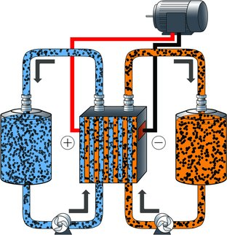
Future development
Refillable Batteries:
http://www.greenmotorsblog.de

Slide 23
Conclusion I
Qualified for the city (short distances)
  Less loud
  Does not have any exhaust gas (it still adds to CO2- emissions to the environment )
Monetary savings
Less emissions

Slide 24
Conclusion II
Less loud -> it is dangerous for walkers
Only for short distances
Long recharge time
Not enough electricity
Better insulation for the electric car (for outdoor temperature)
High-voltage source
No breakdown-service
Expensive: cars as well as batteries and its service

Slide 25
Sources
www.autobild.de
http://theinstitute.ieee.org/ieee-roundup/opinions/ieee-roundup/electric-vehicles-possibilities-challenges-and-their-impact
http://www.paulchefurka.ca/Electric%20Cars%20and%20CO2.html
http://www.chevrolet.com/volt-electric-car/
http://www.alle-autos-in.de/
http://www.lemnet.org/
www.umweltbundesamt.de

Slide 26
Sources
http://en.wikipedia.org/wiki/Electric_car
http://inventors.about.com/od/estartinventions/a/History-Of-Electric-Vehicles.htm
http://www.directoryarc.com/articles/2/1/The-Journey-of-Electric-Vehicles-From-Then-to-Now/Page1.html
http://inventors.about.com/od/estartinventions/a/Electric-Vehicles.htm
http://inventors.about.com/od/cstartinventions/a/History-Of-Electric-Vehicles.htm
http://en.wikipedia.org/
http://electric-car-abc.com

Slide 27
Sources
http://auto.howstuffworks.com/electric-car3.htm
http://www.howstuffworks.com/hybrid-car.htm
http://www.elektroauto-start.de/wissen/elektro-vs-hybrid
http://www.klima-wandel.com
http://www.eliica.com
http://www.stromvergleich.de/elektroauto
http://www.handelsblatt.com/auto/test-technik/batterie-statt-brennkammer/4179482.html?p4179482=all
http://www.elektroauto-hybridauto.de
http://batteryuniversity.com/learn/article/cost_of_power
http://www.allaboutbatteries.com/Battery-Energy.html

Slide 28
http://www.treehugger.com
http://www.greenmotorsblog.de/
“Who killed the electric car” – Chris Paine, 2006

