Slide 1
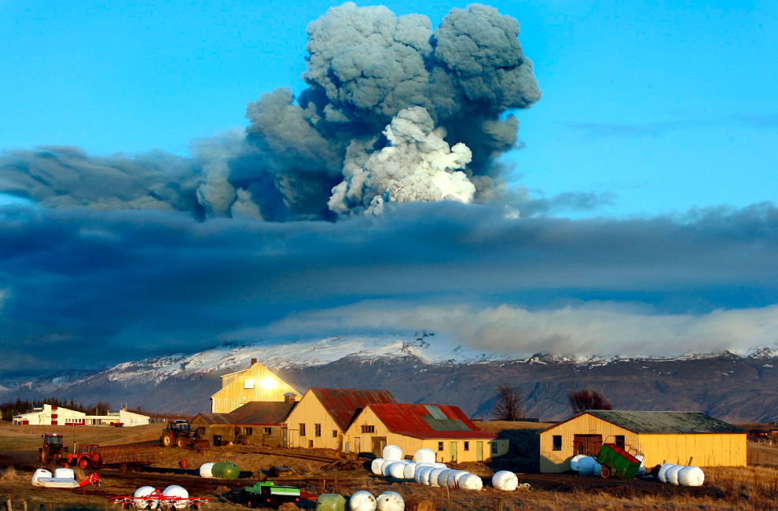
The Impacts of Volcano Eruptions on Global Climate
Nora Strotjohann, Maike Hansen, Victor Rufus

Slide 2
Lecture Outline
Volcanic Eruption Emission and Ejecta
Eruption Classifications
Tectonic Plate Boundaries and Hotspots
Impact on Global climate
Effects of gas injection into atmosphere
Supervolcanoes
Long term global effects

Slide 3
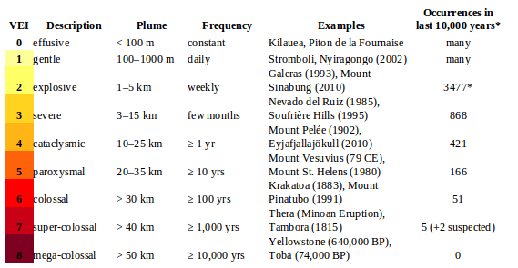
Volcanic Explosive Index (VEI)
VEI = log₁₀(Raised Pyroclastic Material[kg]) – 7

Slide 4
Volcanic Emissions and Ejecta
Tephra
Pyroclastic Flow
Lava Flows
Lahars
Plume

Slide 5
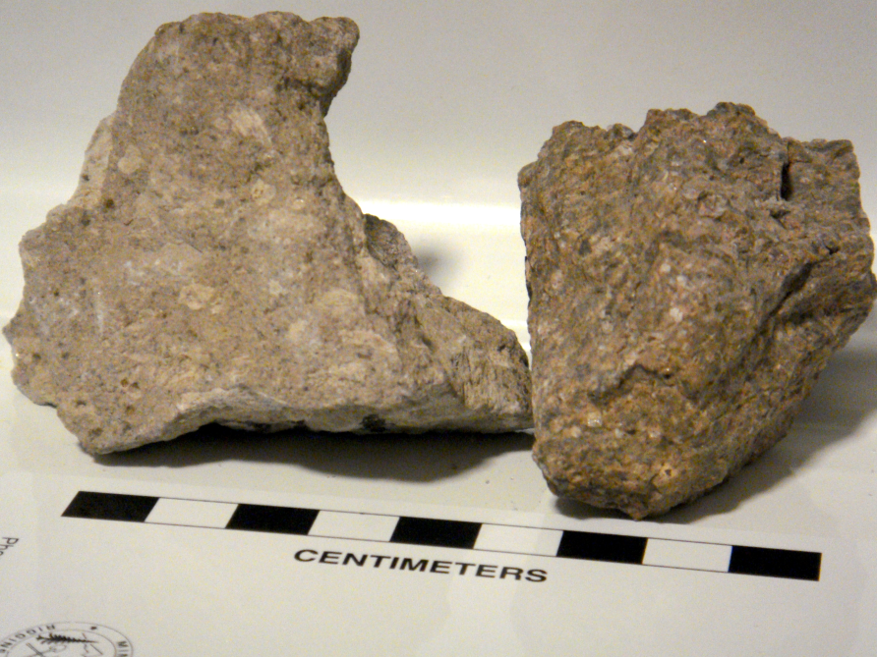
Tephra
Pyroclastic fragments classified by size
Ash - particles smaller than 2 mm in diameter
Lapilli - between 2 and 64 mm in diameter
Volcanic Bombs - larger than 64 mm in diameter.
Examples of Ignimbrite Tuff

Slide 6
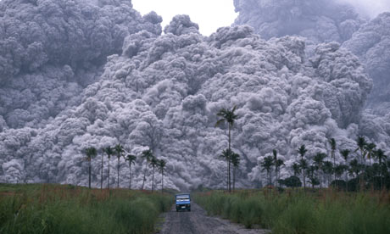
Pyroclastic Flow
Pyroclastic Density Current (PDC)
Superheated gaseous current
Gravitationally driven
Temperature < 1300K, Velocity < 700km/h
Caused by:
Collapse of the eruption column or lava dome or spine
Directional blast when side of volcano explodes

Slide 7
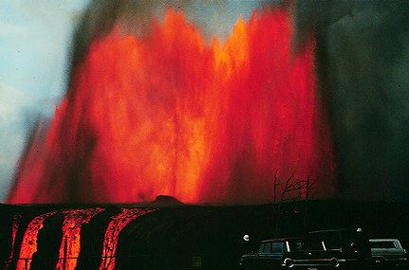
Lava Flows and Fountains
Igneous rock expelled from a volcano during an eruption
Can also be caused by increase/decrease in crustal compression stress
Chemical composition determines viscosity and temperature
Classified into three chemical types
Felsic (rich in SiO₂)
Andesitic (rich in Mg and Fe)
Mafic (low in SiO₂)
Mauna Ulu eruption , Kilauea Volcano, Hawaii

Slide 8
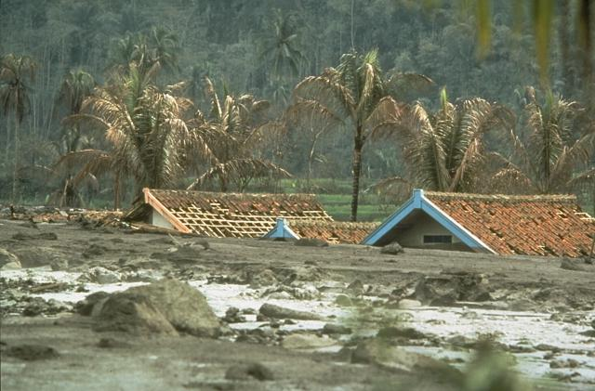
Lahars
Contraction of “Belahar”, Indonesian for “Volcanic Mudflow”
Debris flow consisting of pyroclastic material and water
Can travel up to 100km/h and for up to 300km
Follows the local topography for direction, mostly through river valleys
Occur in tropical or glacial regions
Snow and glacier melt or rainfall and typhoons contribute to the water content
Galunggung, Indonesia

Slide 9
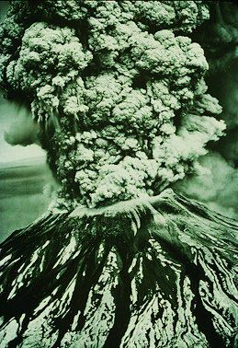
Plume
Eruption column
Hot volcanic ash emitted by an explosive eruption
Height < 10km, plume is washed out by rainfall
> 10km, penetrates stratosphere with ash and volcanic gases.
Mount St. Helens, USA

Slide 10
Classifications of Eruptions
                VEI
Hawaiian 0-1
Strombolian 1-2
Vulcanian 2-3
Peléan 3-4
Plinian * 4 and above
*Includes Ultra-Plinian and Supervolcanic

Slide 11
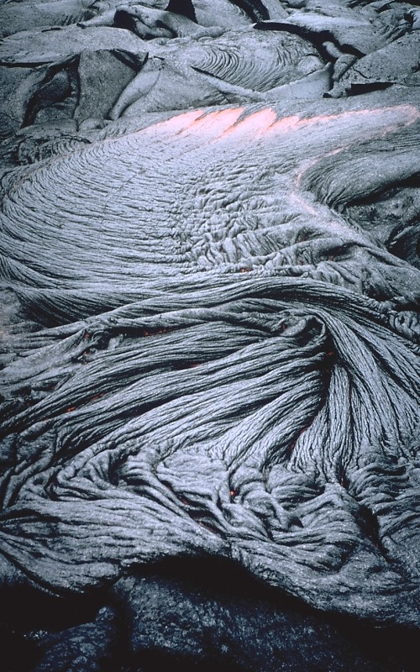
Hawaiian Eruption
VEI of 0 – 1
Effusive eruptions of very fluid basaltic lava flows
Plume < 1000m, comprising mostly ash
Typical eruptions from the Hawaiian Islands Hotspot

Slide 12
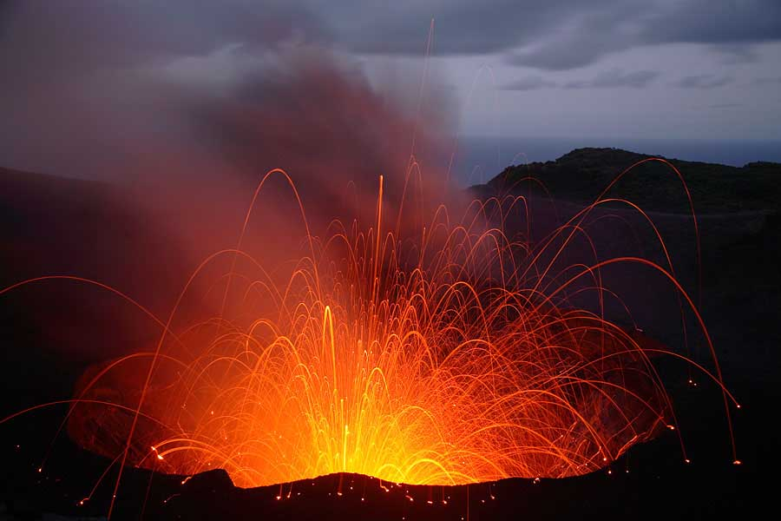
Strombolian Eruption
VEI of 1 – 2
Driven by gas bubbles created by a decrease in crustal compression stress
Gentle eruptions with Plume consisting of all types of tephra, < 3 km
Yasur Volcano, Vanuatu

Slide 13
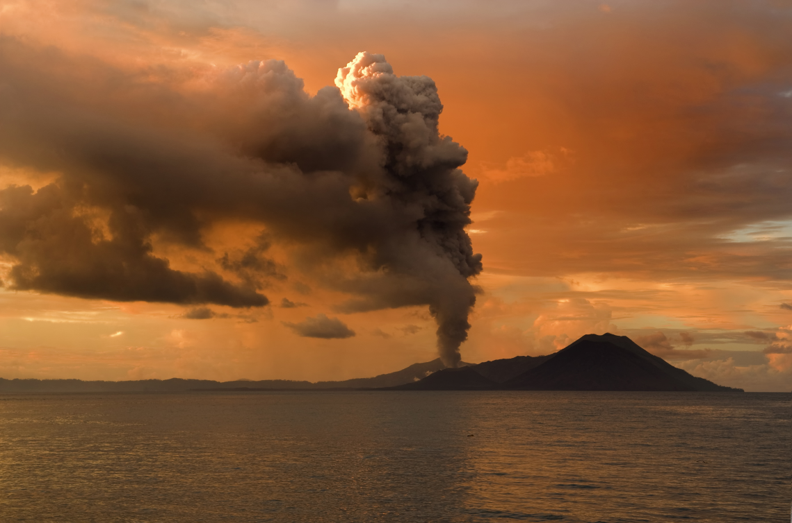
Vulcanian Eruption
VEI of 2 – 3
More explosive than Strombolian eruption
Tephra dispersed over wide area, ash volcanic cone and lava flows
Plume < 10 km
Tavurvur Volcano, Near Rabaul, PNG

Slide 14
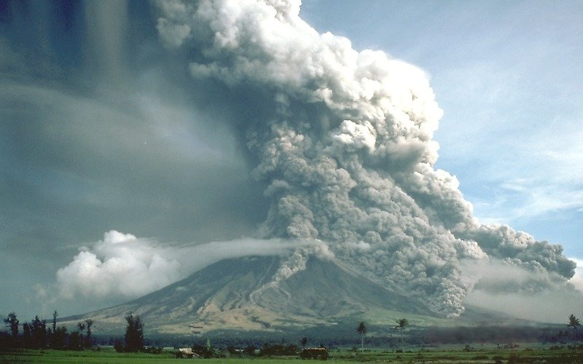
Peléan Eruption
VEI 3 – 4
Avalanches of glowing hot ash flows
Tephra deposits less widespread than Vulcanian and Plinian eruptions
Plume < 20 km
Mayon Volcano, Phillipines

Slide 15
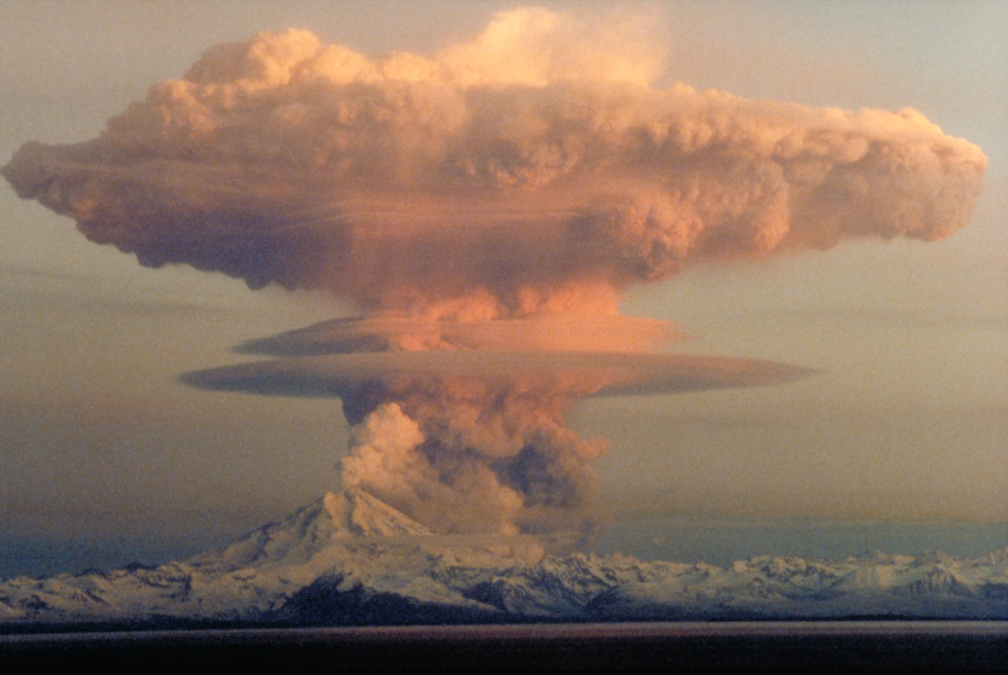
Plinian Eruption
VEI 4 and above
Cataclysmic explosions
Plumes up to 45km in height and can penetrate the stratosphere
Large amount of tephra ejected
Felsic lava flow
Redoubt Volcano, Kenai Peninsula, Alaska, USA

Slide 16
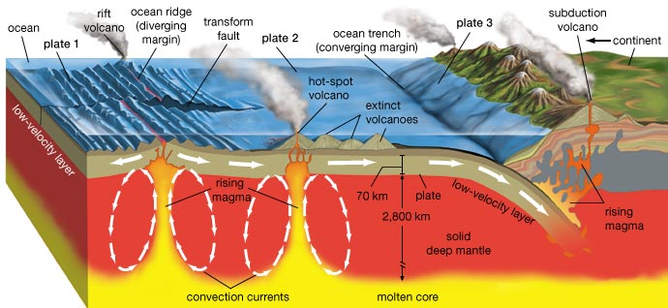
Where volcanoes systems occur?
Divergent Plate Boundaries
Convergent Plate Boundaries
Hotspots

Slide 17
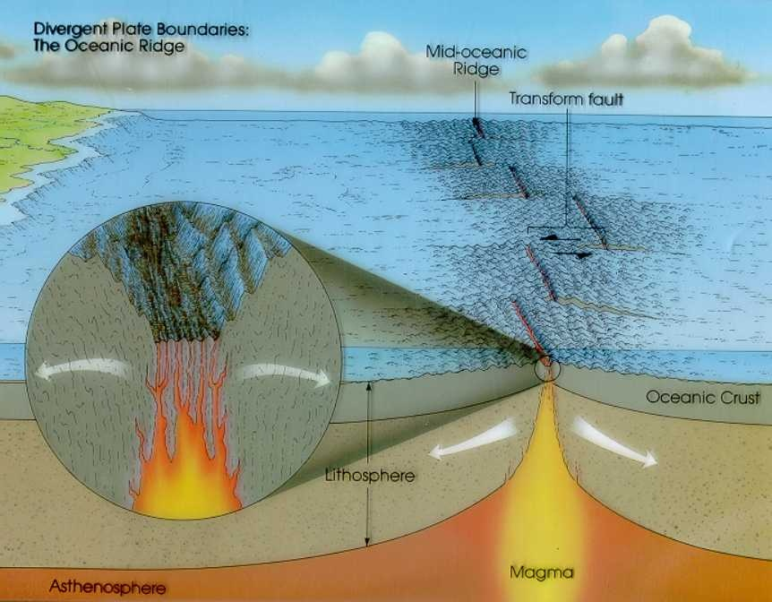
Divergent Plate Boundaries
Volcanoes occur predominantly within oceanic regions
Iceland, best example of diverging oceanic plates breaching sea level

Slide 18
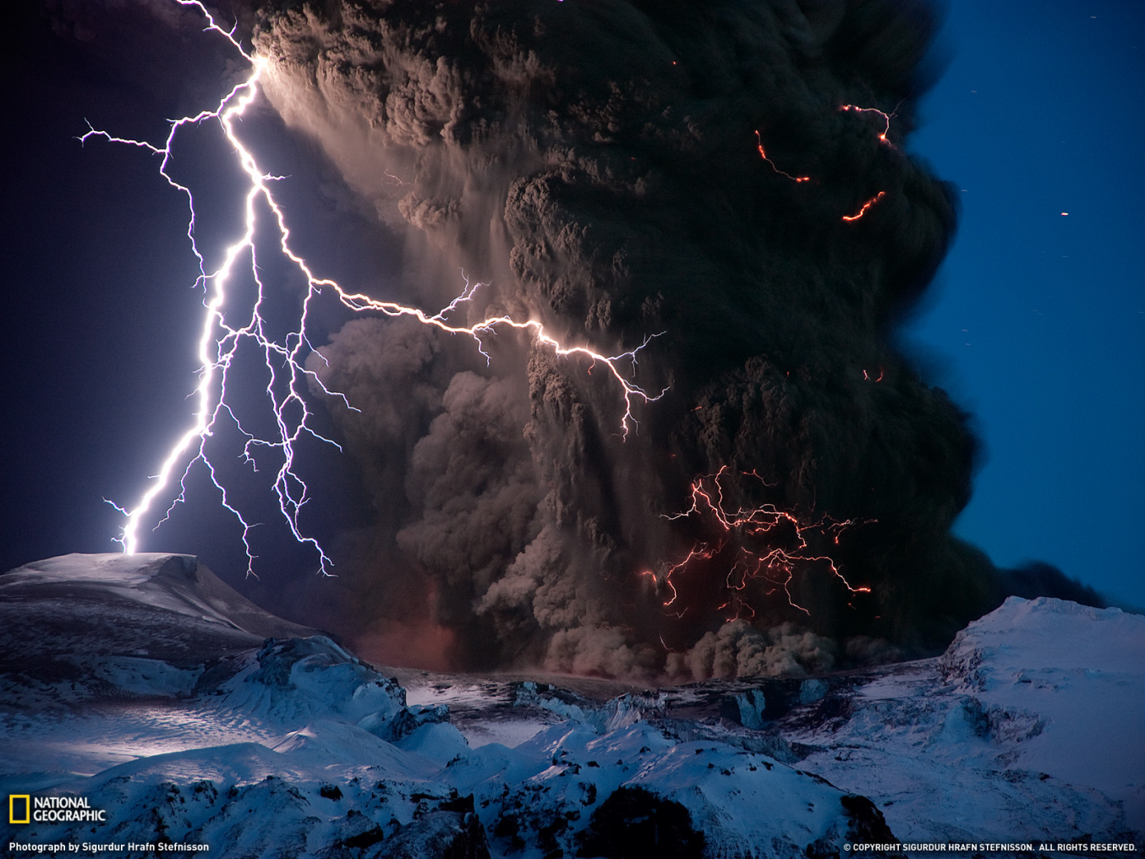
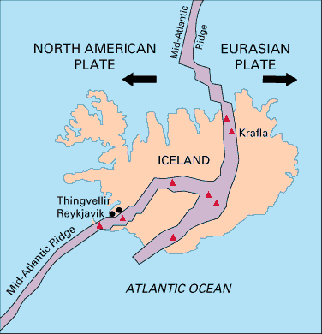
Divergent Plate Boundaries
Eyjafjallajökull, Iceland

Slide 19
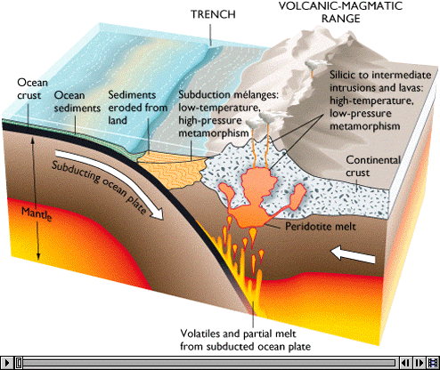
Convergent Plate Boundaries
Oceanic – Continental Subduction Zone
Resulting in mountain ranges and volcanoes on continental plates

Slide 20
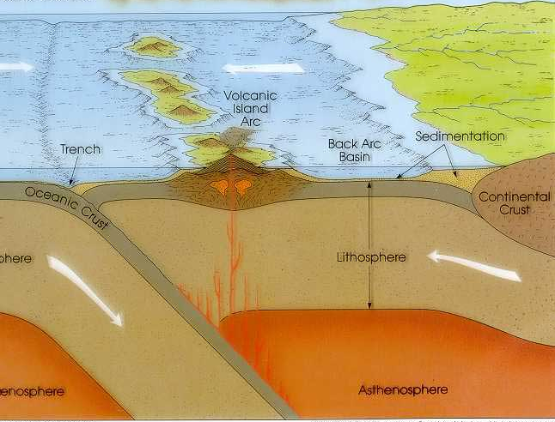
Convergent Plate Boundaries
Oceanic – Oceanic Subduction Zone
Creates Volcanic Arcs

Slide 21
Convergent Plate Boundaries
Mt Vesuvius (erupted 79 AD), VEI=4 Apennines Subduction System
Pinatubo (1991) VEI=6, formed by the Phillipine Mobile Belt sliding over the Eurasian Plate along the Manila Trench to the west
Lake Toba (74 000 BP) VEI=8, part of the Sunda Arc, a result of the northeasterly movement of the Indo-Australian Plate which is sliding under the eastward-moving Eurasian Plate
Mount Tambora (1815) VEI=7, on the island of Sumbawa, Indonesia, is flanked both to the north and south by oceanic crust. This raised Mount Tambora as high as 4,300 m (14,100 ft), formerly one of the tallest peaks in Indonesian archipelago.

Slide 22
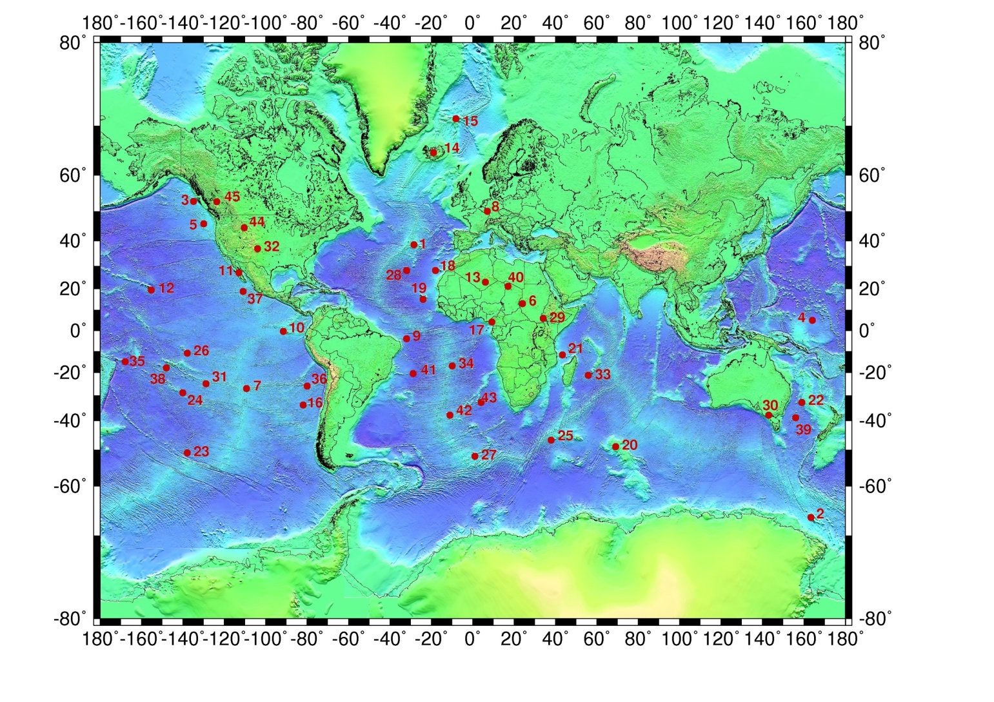
Hotspots

Slide 23
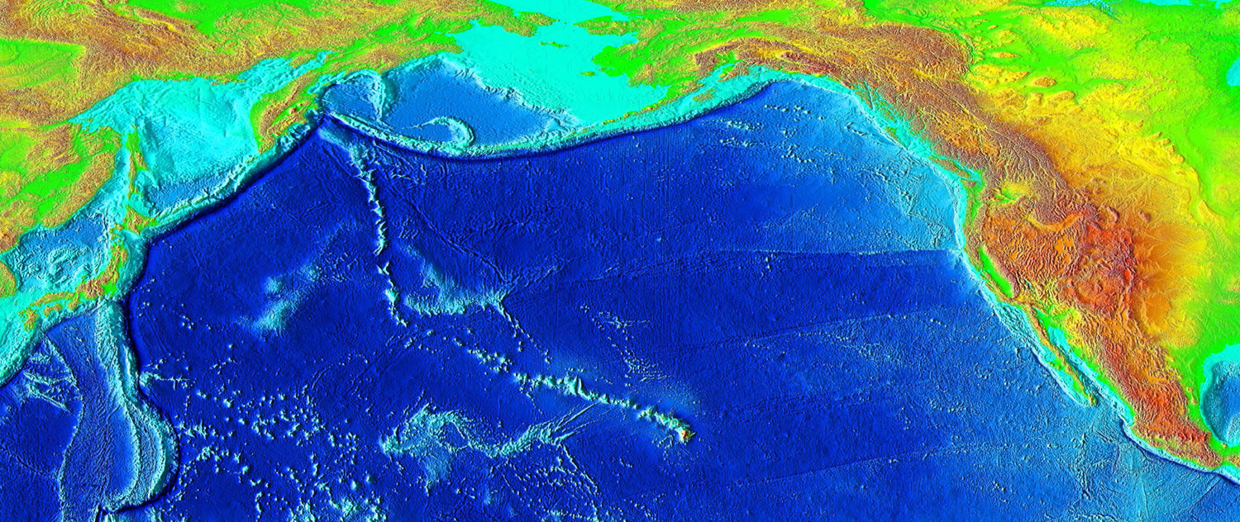
Hotspots
Yellowstone (640 000 BP) VEI=8
Hawaiian Hotspot

Slide 24
Impact on Global Climate

Slide 25
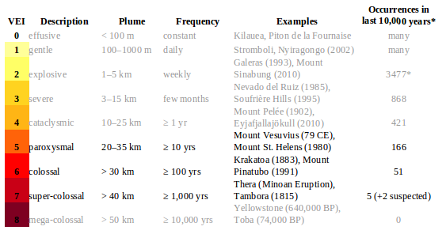
Volcanic Explosion Index
Volcanic Explosion Index

Slide 26
Emitted gases
Only injection in stratosphere (8 – 18km height) has to be considered, otherwise washed out by rain
Mainly H₂O and C0₂ (greenhouse gases)
Sulfur → most important impact
Chlorine and others in small amounts

Slide 27
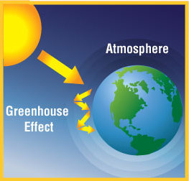
The Greenhouse Effect
Mainly water vapor, C0₂, methane, N₂O
Emissions by volcanoes normally > 1% compared to human-made CO₂
Cooling due to aerosols (sulfur) dominates

Slide 28
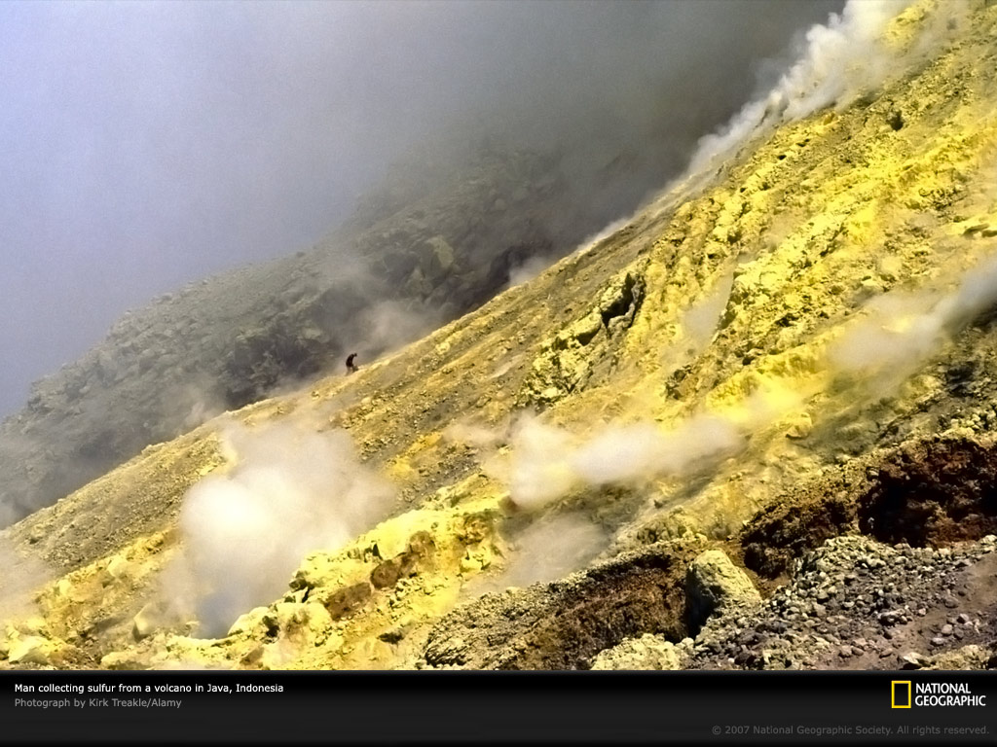
Sulfur Emissions

Slide 29
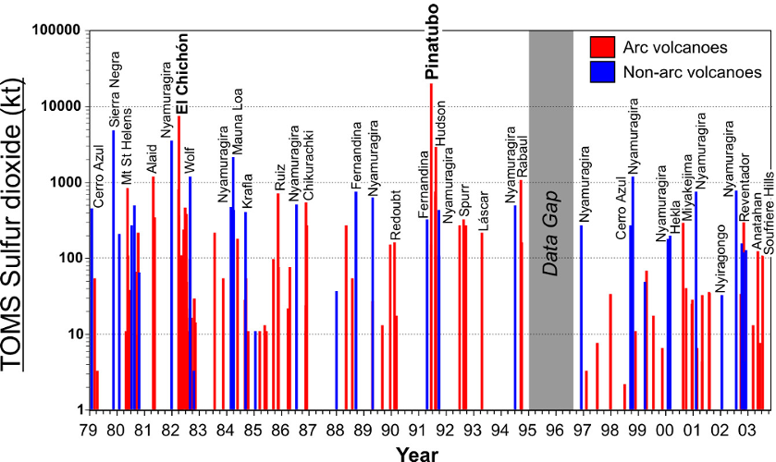
Sulfur Emissions

Slide 30
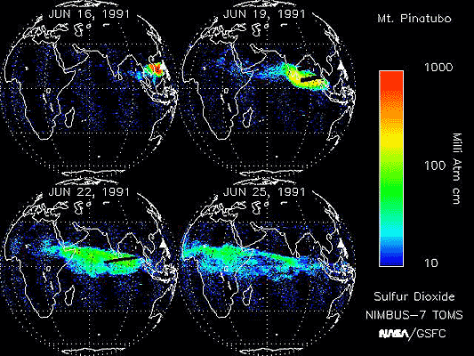
Pinatubo Aerosol Cloud

Slide 31
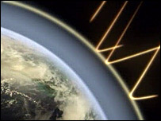
Sulfur Acid Aerosols
Aerosol = liquid/solid particle that floats in gas
sulfur + water → sulfur acid (70:30)
Icy or liquid spheres with d~500 nm
solar radiation is absorbed, scattered or reflected → increased albedo
Slowly settle down during
the next 1-3 years

Slide 32
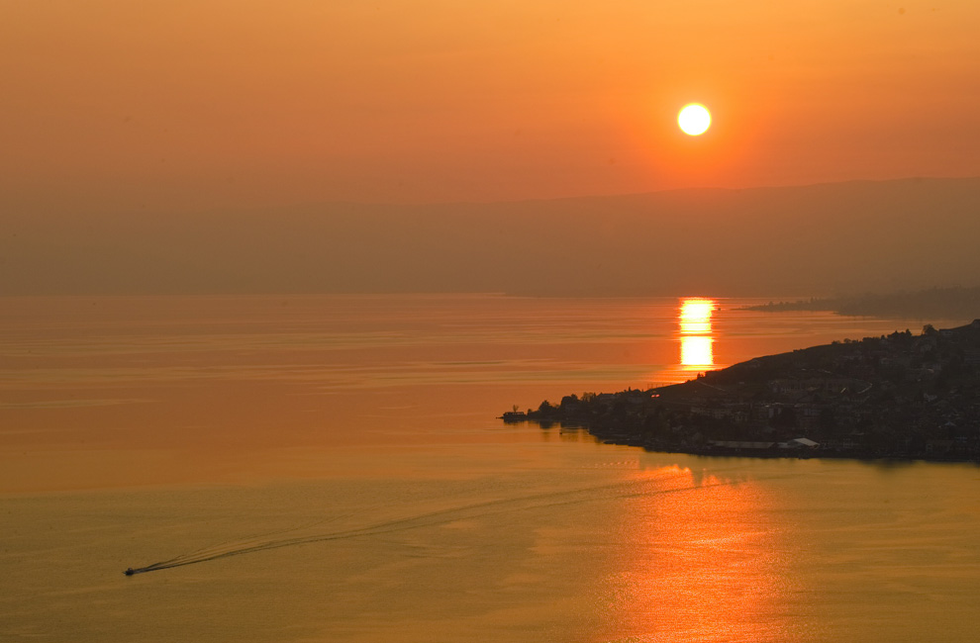
Iceland 2010

Slide 33

Painted some years after the Krakatoa eruption (Indonesia)
Iceland 2010

Slide 34
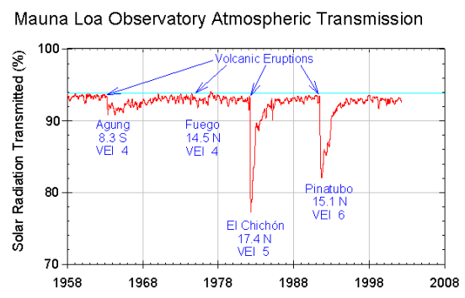
Cooling Effect

Slide 35
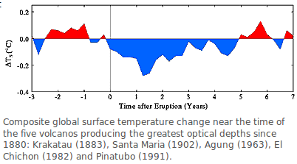
Cooling Effect

Slide 36
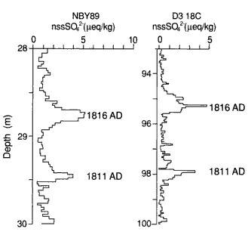
Sulfur deposition in Iceshields
Cores from Antarctic and Greenland
1815 Eruption of the Tambora (Indonesia)
1809 “Unknown Eruption”

Slide 37
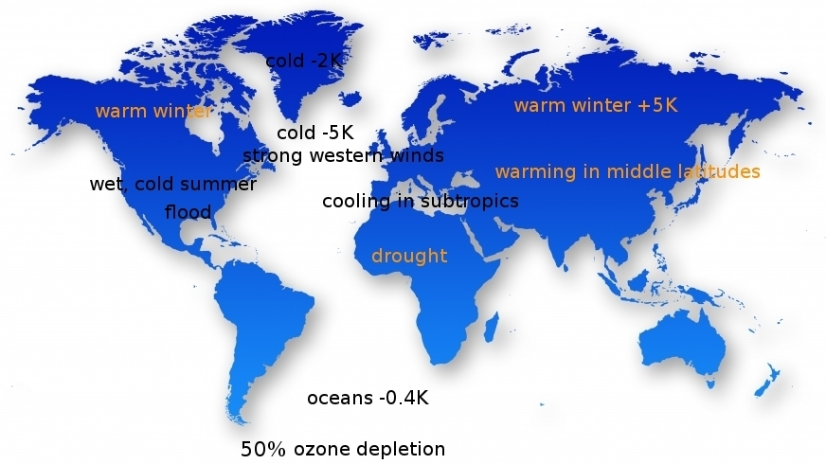
Weather anomalies after Pinatubo eruption
Global cooling of 0.2K
→ Global and local weather patterns influenced

Slide 38
Effect on Ozone Layer
Ozone layer is in stratosphere (shields earth from UV radiation)
Natural balance disturbed by human-made chlorofluorocarbons (CFC)
Volcanic aerosols increase impact of CFCs
Pinatubo: ozone depletion by 50% over Antarctica
Recovers within some years

Slide 39
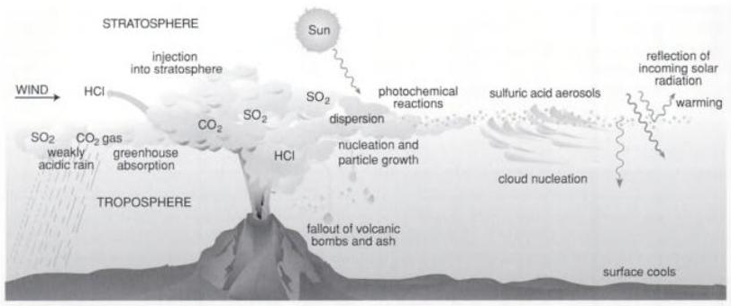
Effects on the Atmosphere

Slide 40
Super-Volcanoes

Slide 41
Super-Volcanoes
Volcanoes that erupt more than 1 000 km³ of tephra (pumice and ash) in a single event
Eruptions 100 times stronger than normal eruptions
VEI > 7

Slide 42
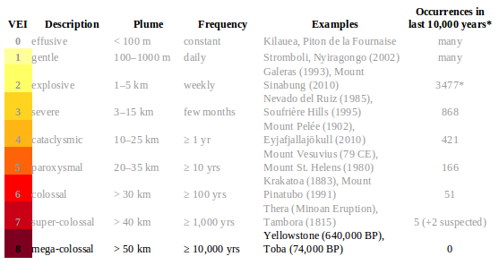
Volcanic Explosion Index

Slide 43
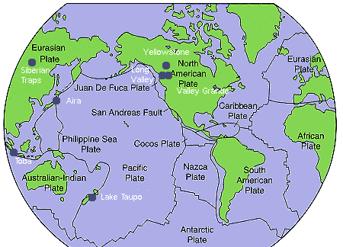
Super-Volcanoes

Slide 44
Consequences of a Super-eruption
Volcanic ash covers a large part of a continent
Climatic changes: Aerosols and fallout in atmosphere for up to six years → atmosphere reflects solar radiation back and absorbs heat
→ cooling of 3-5K for Toba-like eruption
→ Volcanic winter

Slide 45
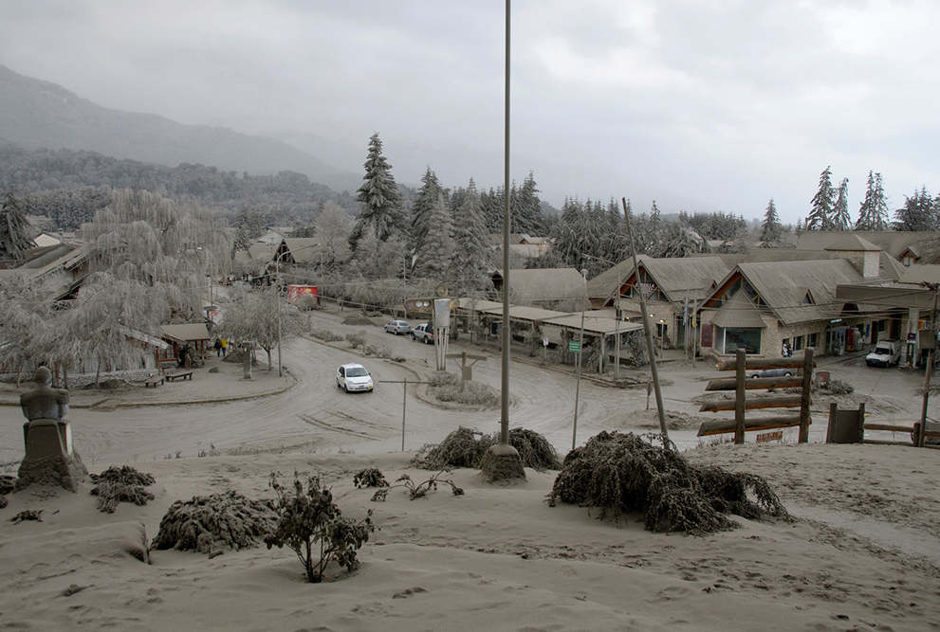
Volcanic winter
Puyehue volcano erupts in Chile , June 2011, http://www.boston.com/bigpicture/2011/07/ash_covered_landscape.html

Slide 46
Volcanic winter
1815 Mount Tambora in Indonesia (VEI=7)
→ frost and snow in summer in New England
Super volcano eruption could reduce radiation of the sun by 25%

Slide 47
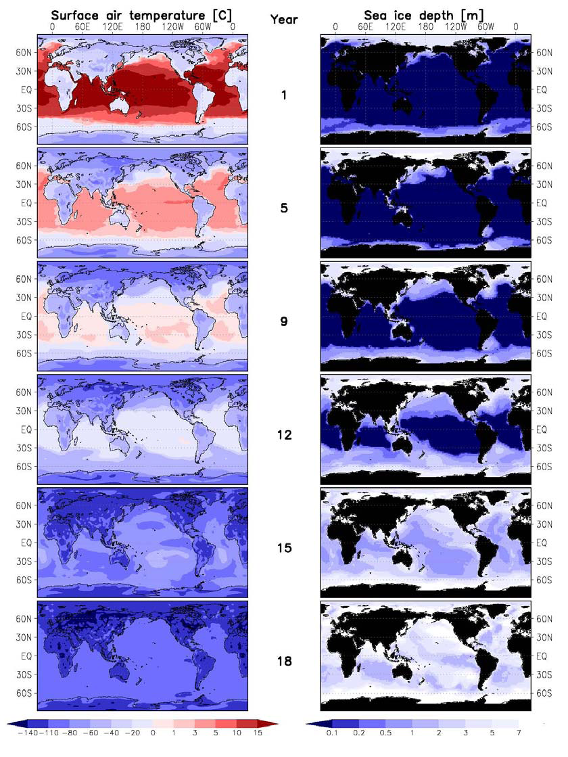
Snowball experiment - 0% radiation
Without radiation
→ sea freezes totally within
15 years
http://www.mpimet.mpg.de/en/science/internal-projects/super-volcano/presentations.html

Slide 48
Consequences of a Super-eruption
Climate system is complex → not sure whether observations from smaller eruptions can be extrapolated
Maybe also other effects become important e.g. C0₂ and Methane concentration in the atmosphere, air pollution and ozone depletion
Can produce huge hurricanes

Slide 49
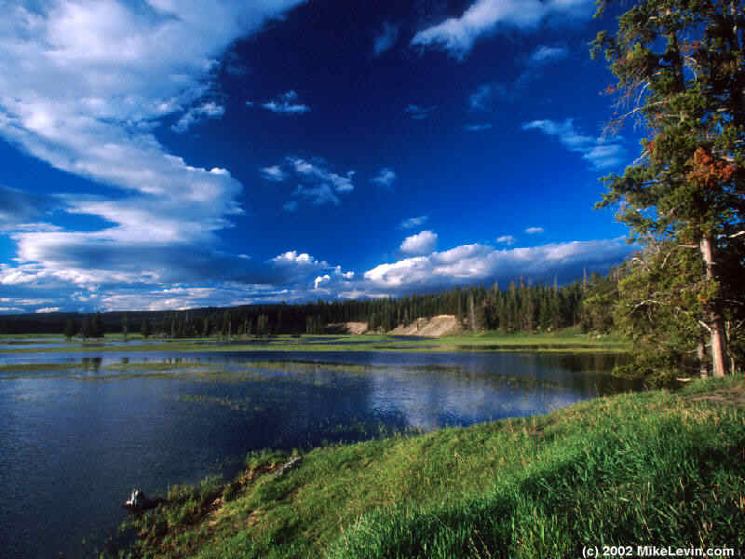
Yellowstone

Slide 50
History
Last super-eruption 640 000 BP
Long thought to be extinct
1973 north of lake had risen 0.76m since 1923
1985 swarm of tiny earthquakes → volcano alive
In the 1950s 3 ash layers found → sign of huge pyroclastic flows

Slide 51
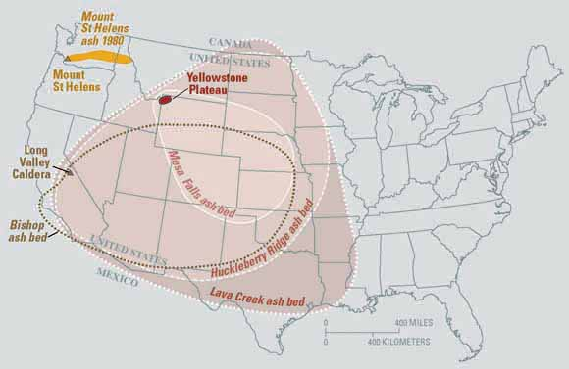
Ashlayers

Slide 52
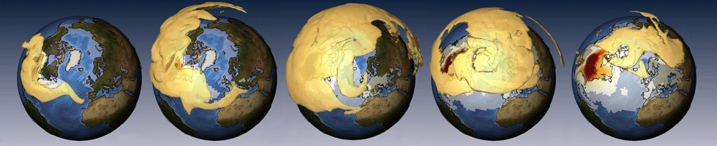
Future of Yellowstone
Simulation for a Yellowstone eruption
Yellowstone eruption very unlikely but possible
Ash would spread around the word
Global cooling effect as seen for Pinatubo would be much larger→ new ice age?

Slide 53
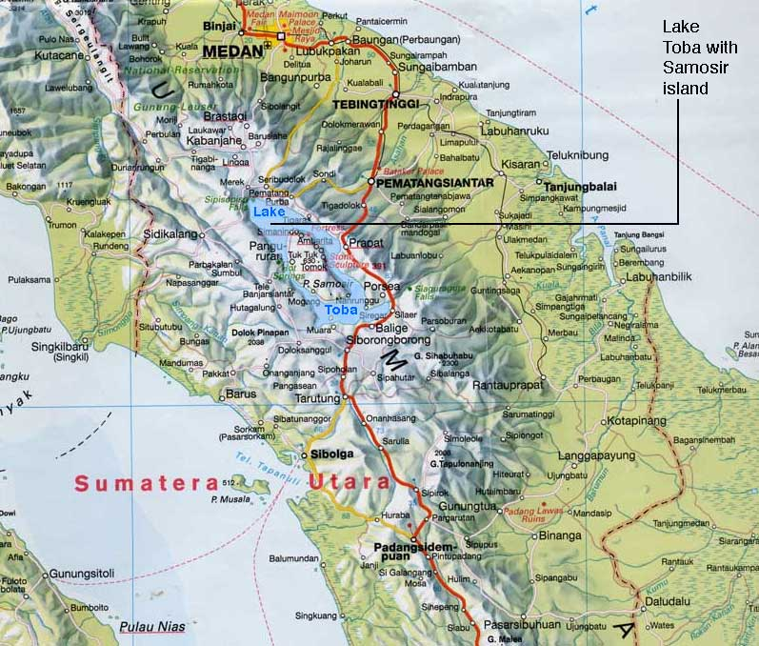
Lake Toba (Sumatra, Indonesia)

Slide 54
Lake Toba: Toba catastrophe
Erupted 74 000 BP
300x stronger than Tambora eruption in 1815
6 - 10 years volcanic winter
Genetic bottleneck theory :
human population reduced to 10 000 or 1 000 pairs

Slide 55
Conclusion and Findings
Volcanic Eruption Emission and Ejecta
Eruption Classifications
Tectonic Plate Boundaries and Hotspots
Impact on Global climate of Plinian eruptions of VEI>5
Global cooling (eg. Pinatubo of 0.2K for approx. 3 yr)
Complexity of climate systems, limited predictability
VEI >7 Supervolcanoes
Significant related climate changes
Expected global cooling (3-5K for approx. >4 yr)

Slide 56
“The bright sun was extinguish'd and the stars
Did wander darkling in the eternal space,
Rayless, and pathless, and the icy earth
Swung blind and blackening in the moonless air;
Morn came and went - and came, and brought no day...”
A section from "Darkness" by Lord Byron, written in June 1816 on the shores of Lake Geneva in the midst of the "Year without Summer“, 14 months after the great eruption of the Tambora volcano in Indonesia.

